Slide 1
Introduction to Computing for Data Analysis
Does my (numerical) program compute the right answer?
Richard Vuduc, Ph.D.
Associate Professor
School of Computational Science and Engineering
The IEEE-754 Binary Encoding
Notes:
To answer this question about whether you can expect your program to produce a good answer, you’re going to need two tools.
The first is a more precise understanding of how numbers are stored and manipulated. That’s the topic of this lesson.
It’s an important foundation. Why? Because from it we’ll be able to develop a more abstract model for reasoning about – and then proving – that our programs can produce meaningful answers.
Even if we only get a finite number of bits and rounding errors occur.
So with that as motivation, let’s get started.

Slide 2
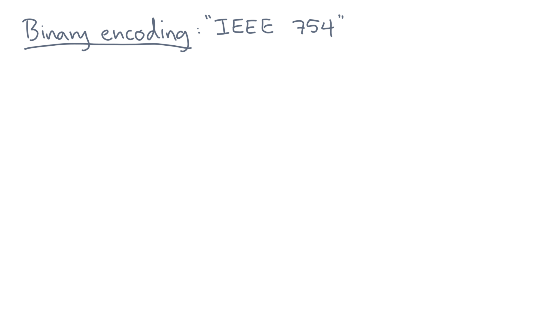
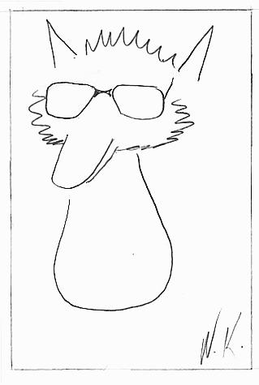
Notes:
Almost all modern computers store floating-point values in the same way.
It’s a format referred to as the IEEE-754 standard.

Slide 3
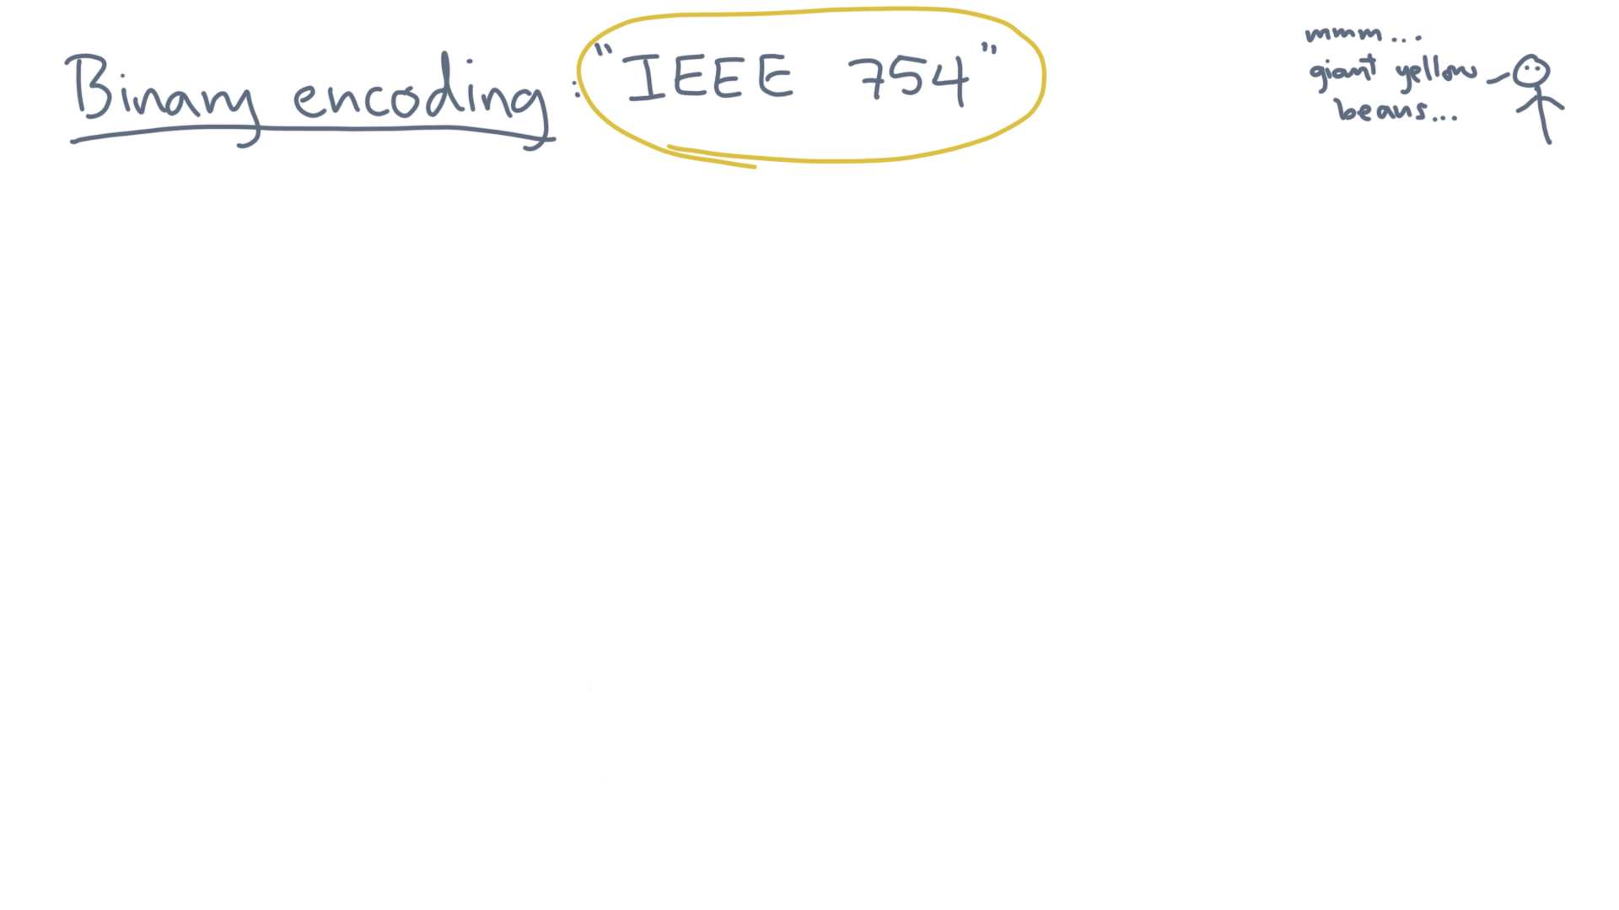
Notes:
Let’s look at some of its most important features, based on what you’ve learned so far.

Slide 4
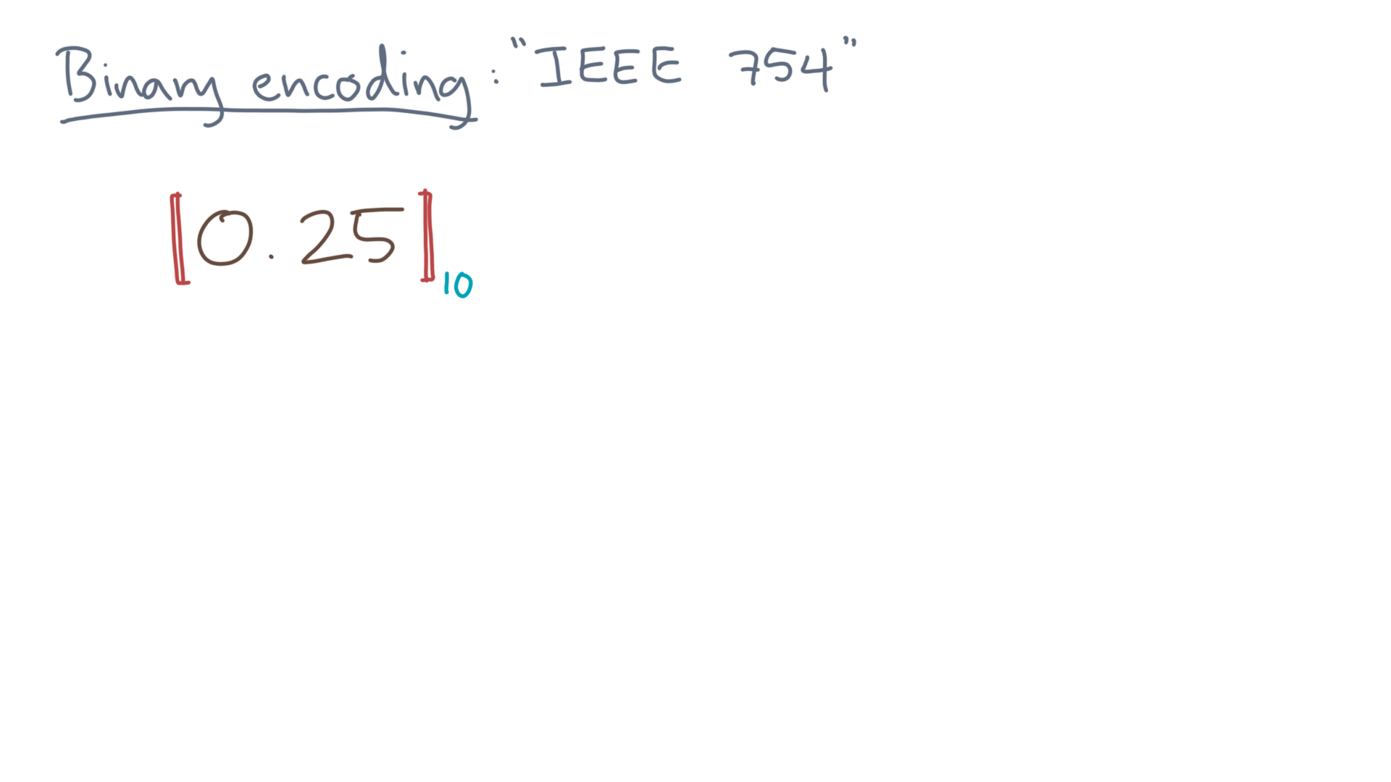
Notes:
Suppose we ask for the mathematical value of some string, like 0.25, in base 10.

Slide 5
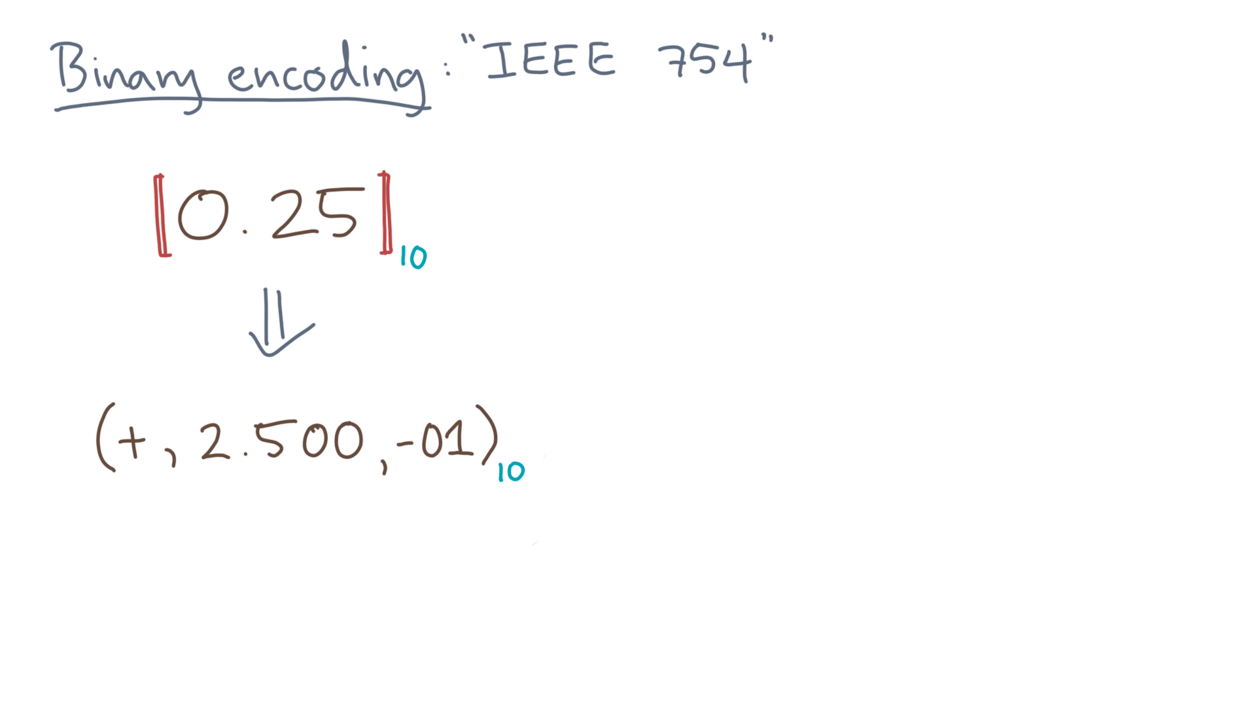
Notes:
Remember our tuple notation, consisting of a sign, significand, and exponent.

Slide 6
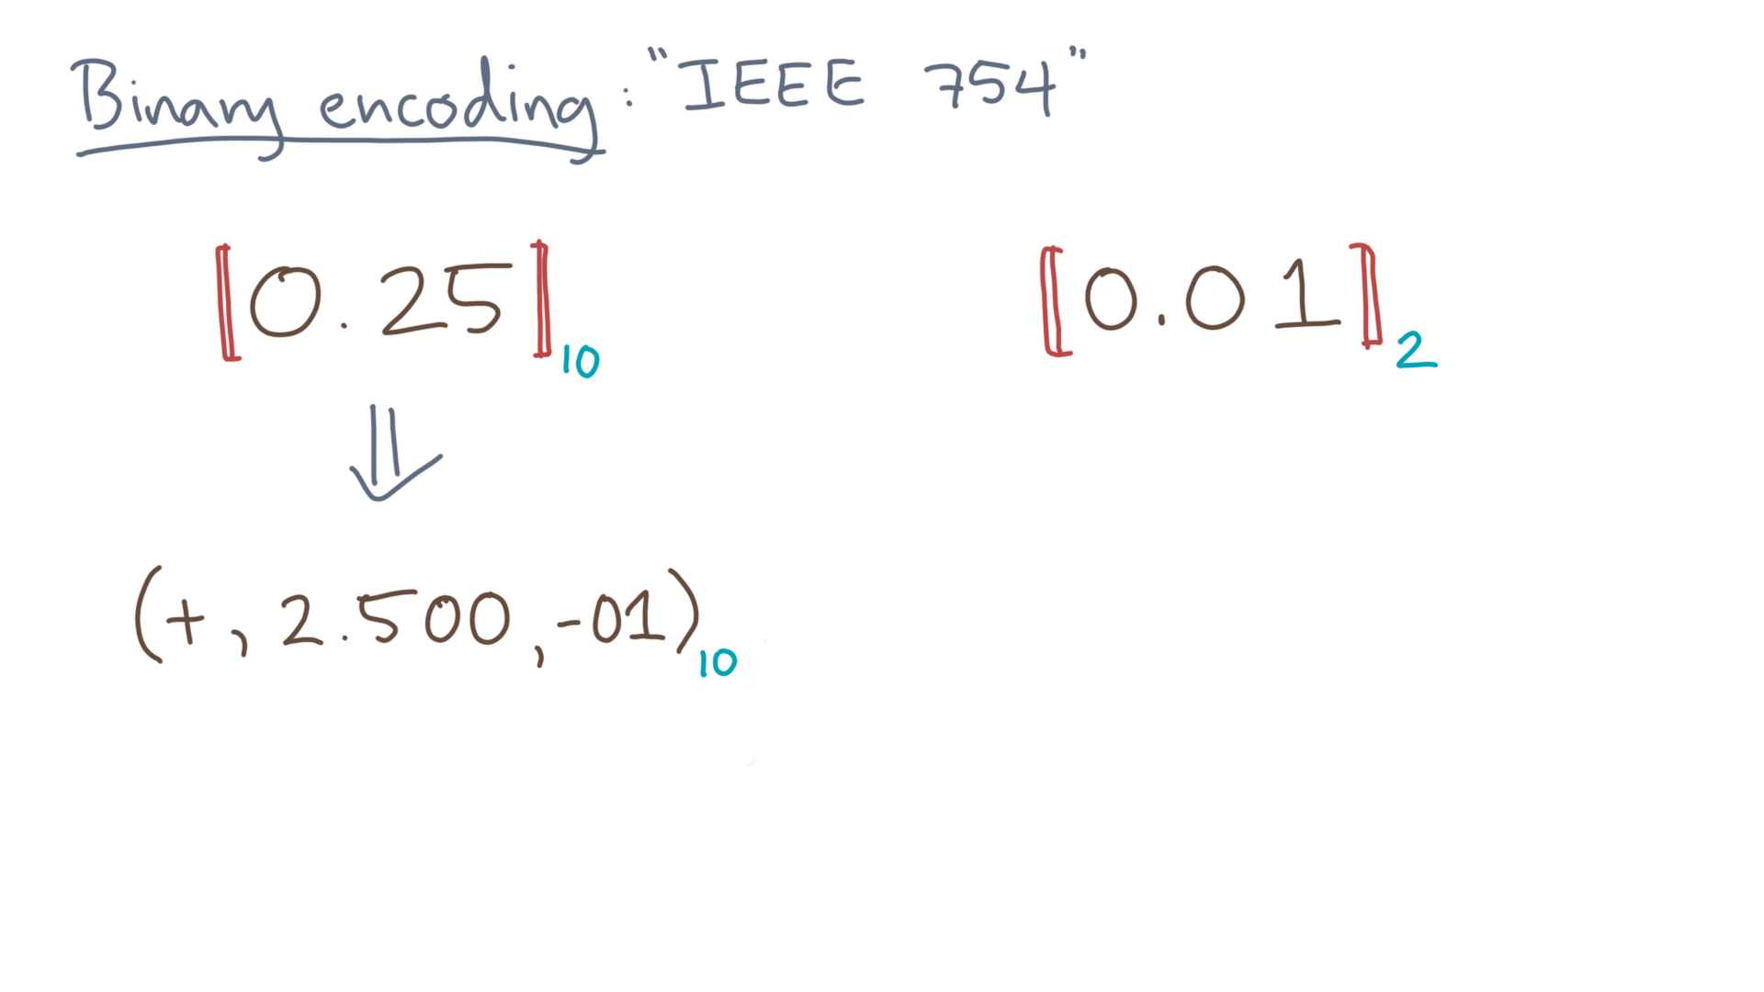
Notes:
The same idea works in any base, such as binary or base-2.

Slide 7
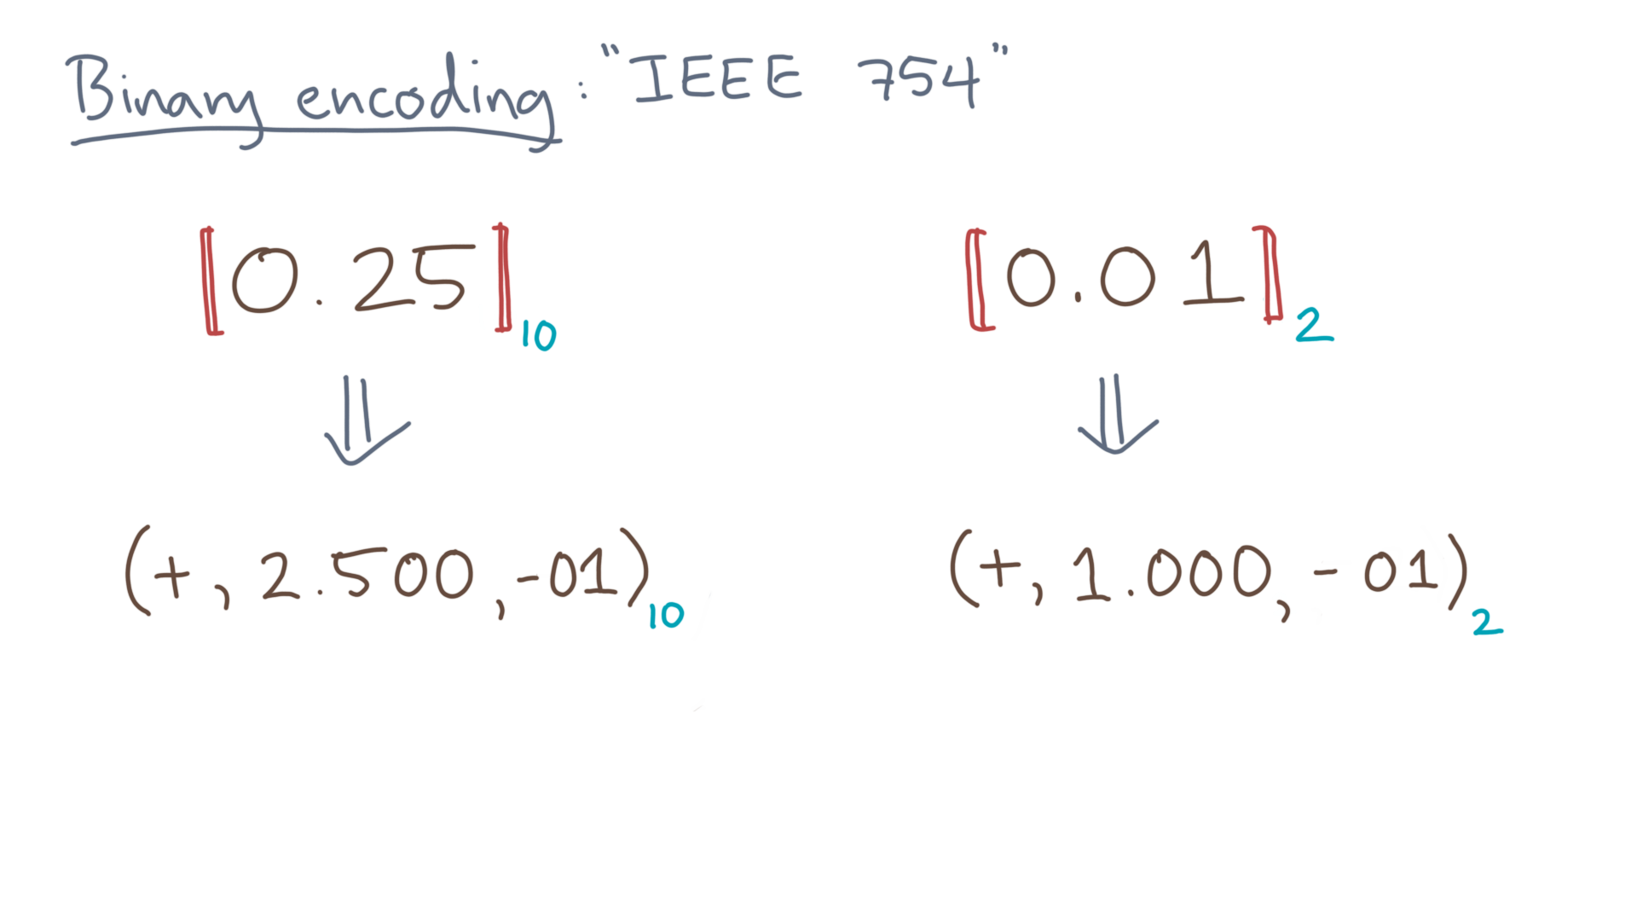
Notes:
IEEE-754 describes how to store and do arithmetic in both decimal and binary bases, but for the moment, let’s focus only on the binary case.

Slide 8
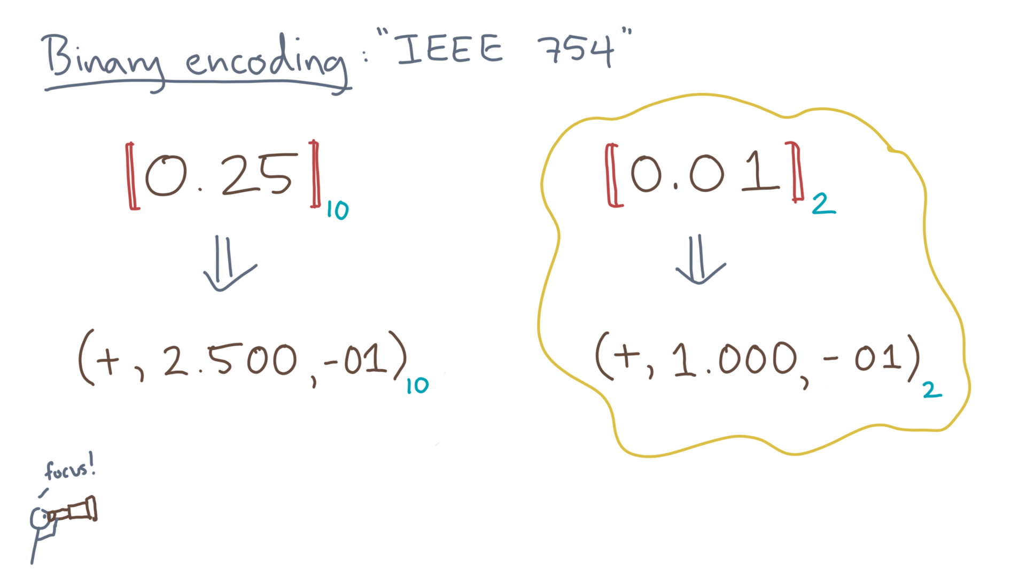
Notes:
To start, consider any finite tuple representation in binary.

Slide 9
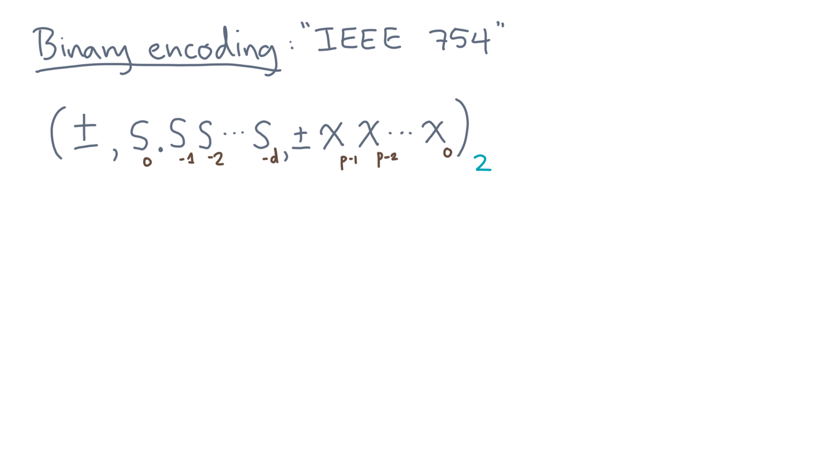
Notes:
First, there’s the sign.

Slide 10
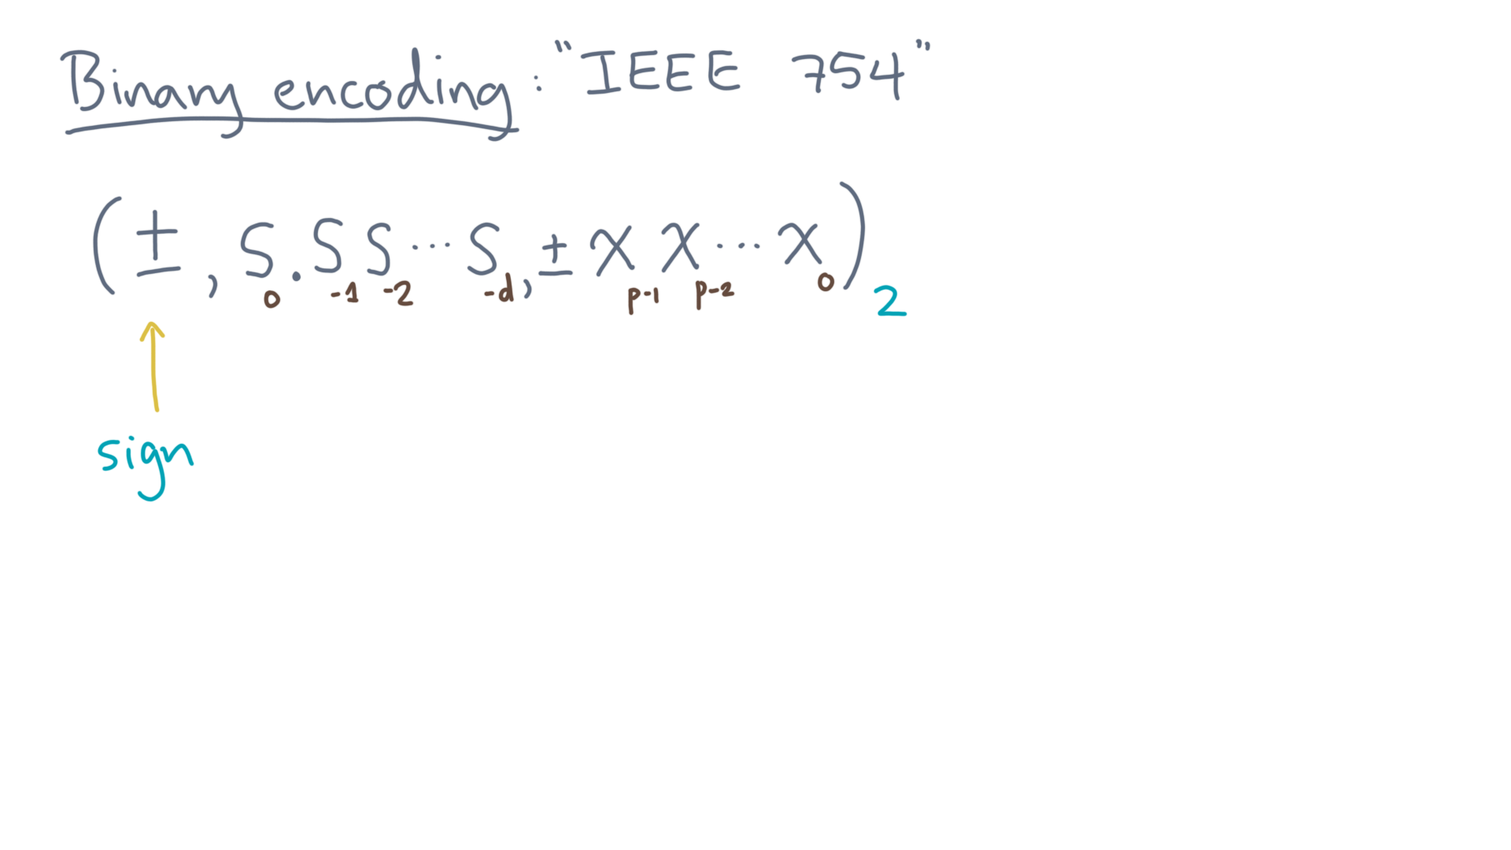
Notes:
Next, there’s the significand.

Slide 11
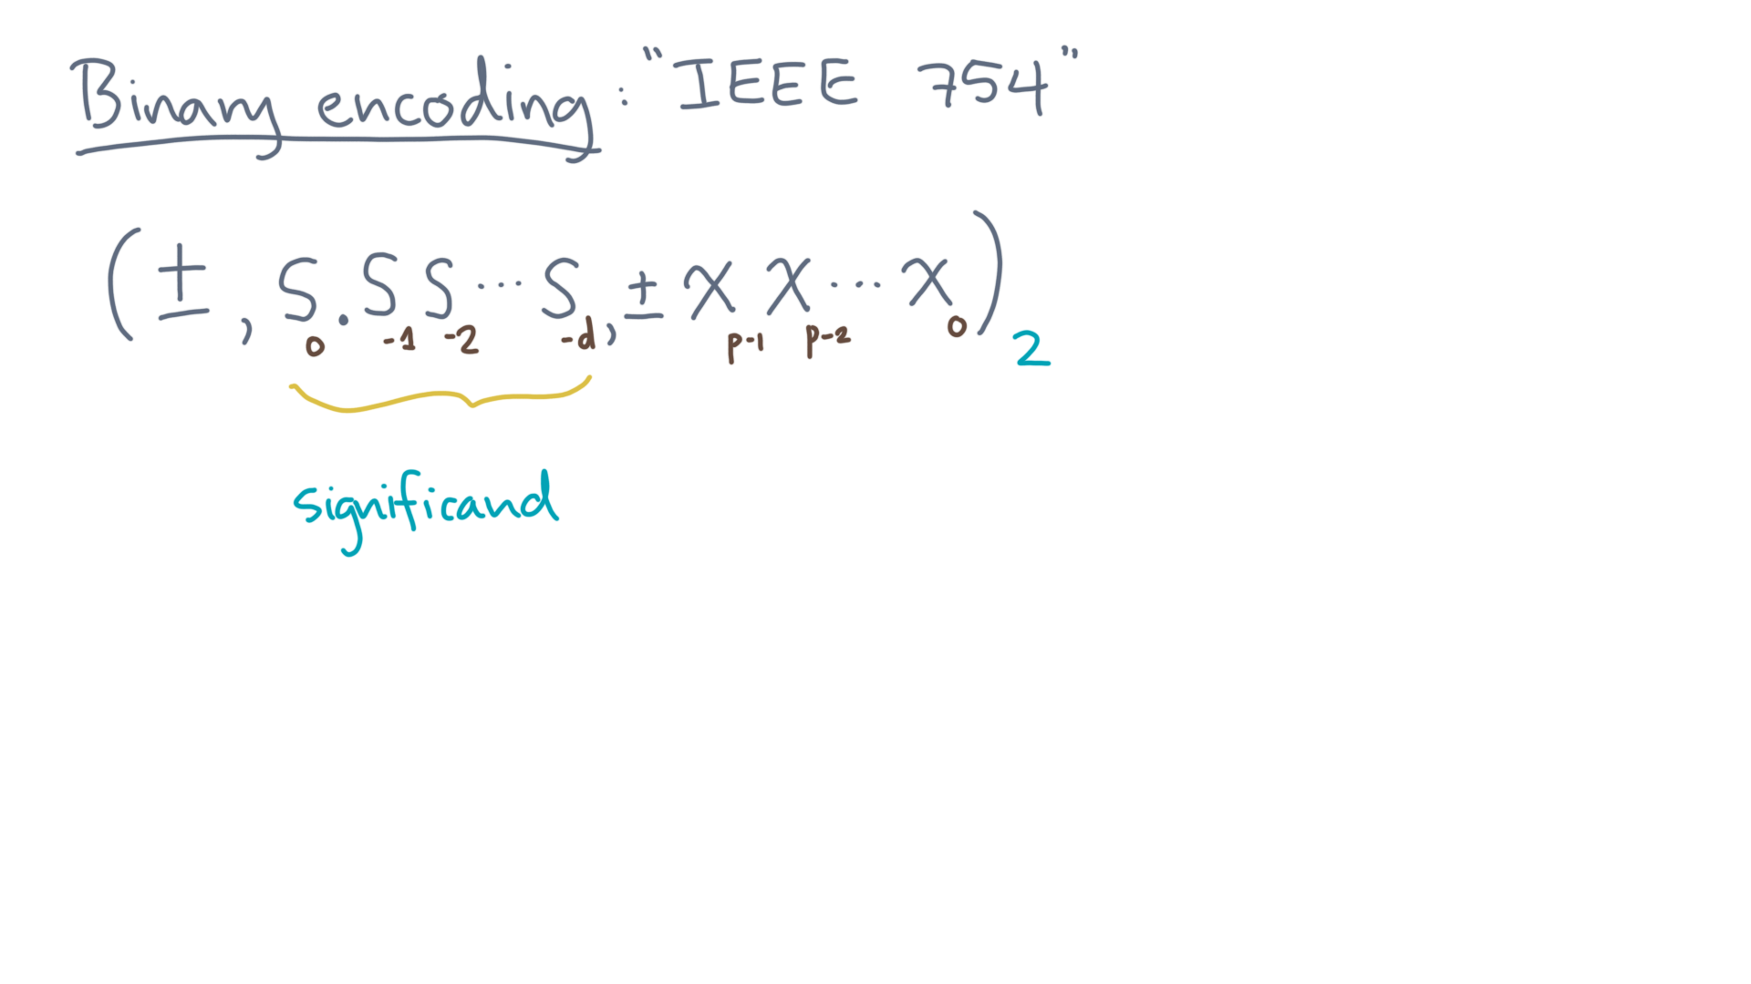
Notes:
And let’s suppose in particular that there are “dee” digits for the fractional part.
And lastly there’s the exponent.

Slide 12
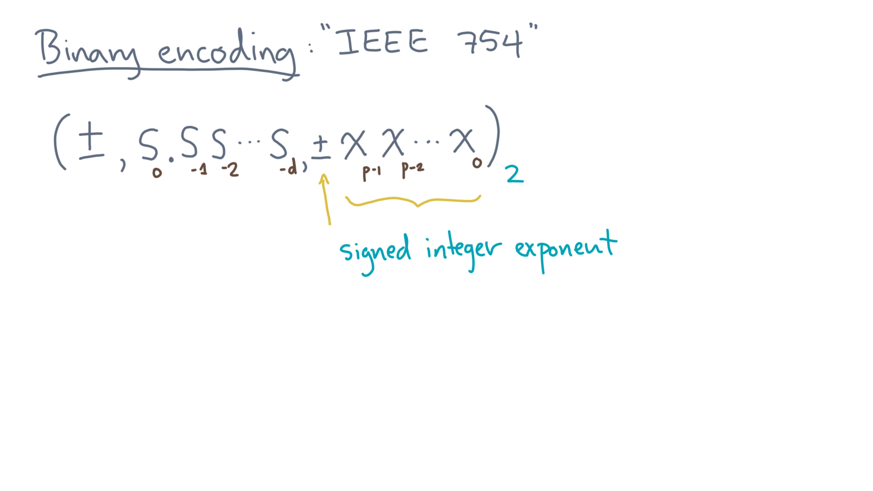
Notes:
We will take this to be a signed integer with “pee” digits.
IEEE-754 implements the tuple in a slightly different way than what we’ve discussed so far.
Let’s see how.

Slide 13
Notes:
First, consider the significand.

Slide 14
Notes:
The IEEE standard says that if the value being represented is *not* zero, then the leading digit is always *implicitly* equal to one.

Slide 15
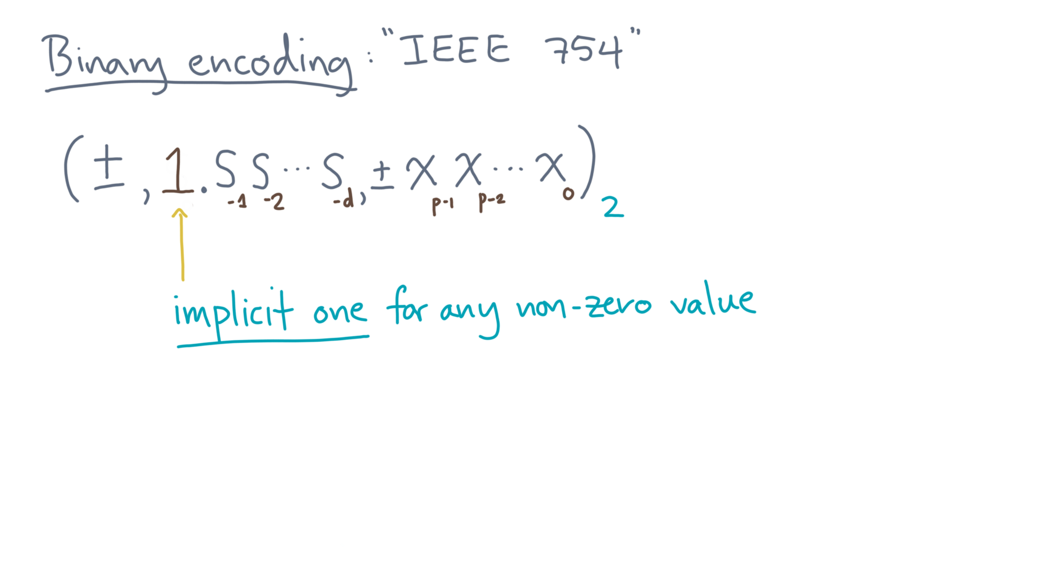
Notes:
There are at least two reasons for that.
First, by the convention of scientific notation, you always have a digit to the left of the fractional point.
In binary, that number can only be one, unless the entire number is zero.

Slide 16
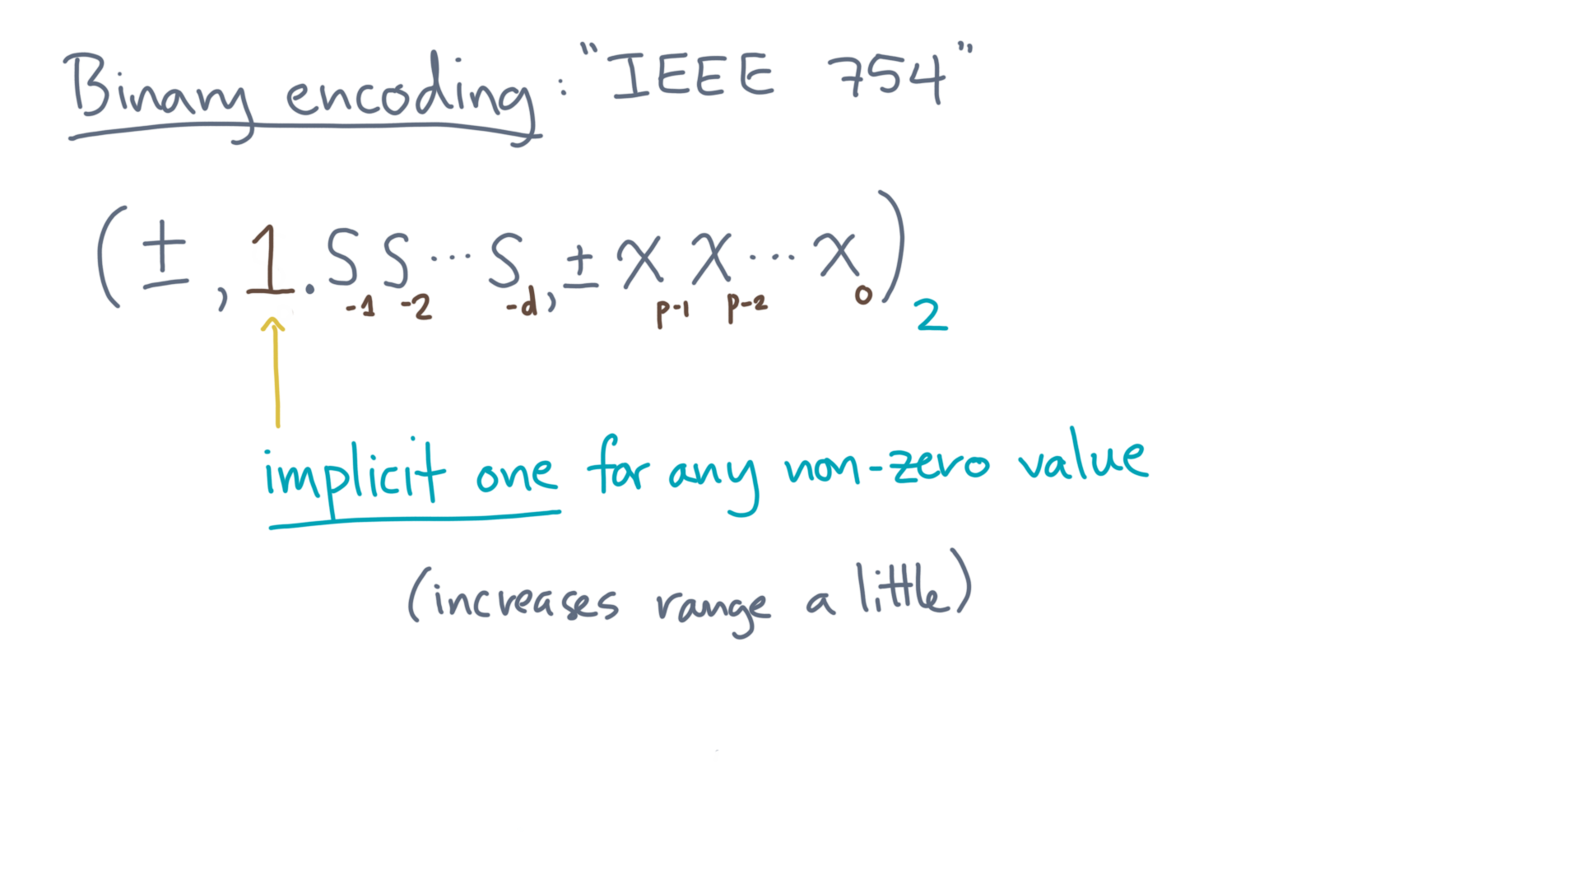
Notes:
Secondly, if it’s always equal to one, then you don’t need to store it at all.
That saves you one bit of storage in the overall representation, which effectively increases the range of values you can represent.
The next thing the standard says concerns the exponent.

Slide 17
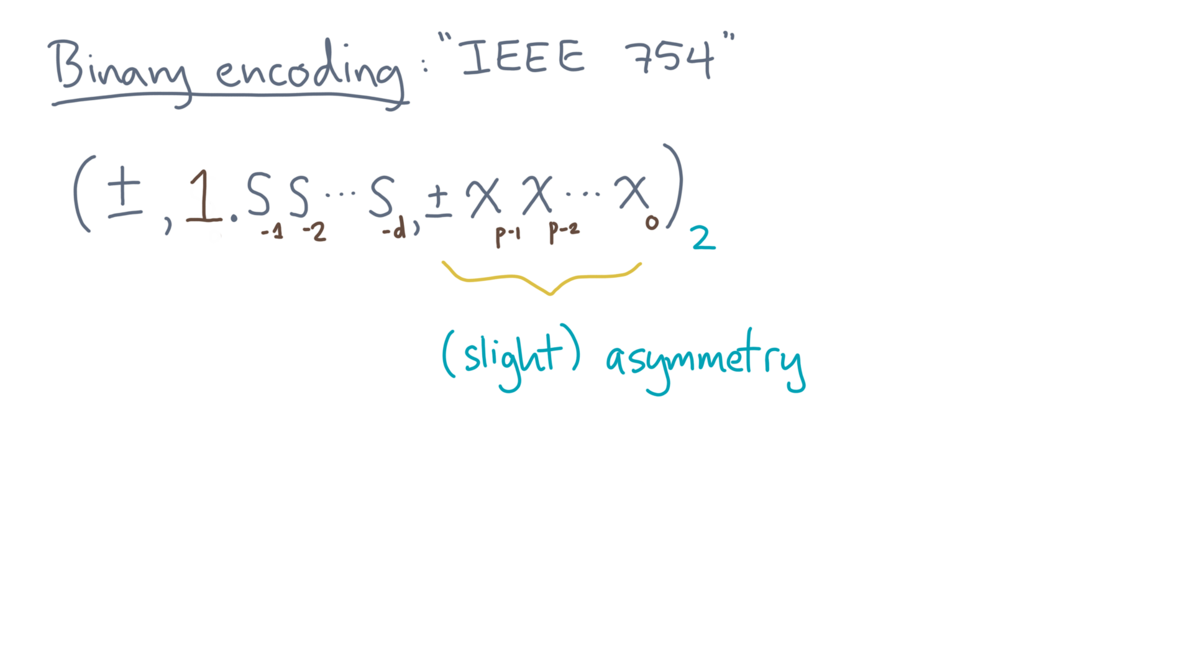
Notes:
In particular, it says the exponent range will be slightly asymmetric.

Slide 18
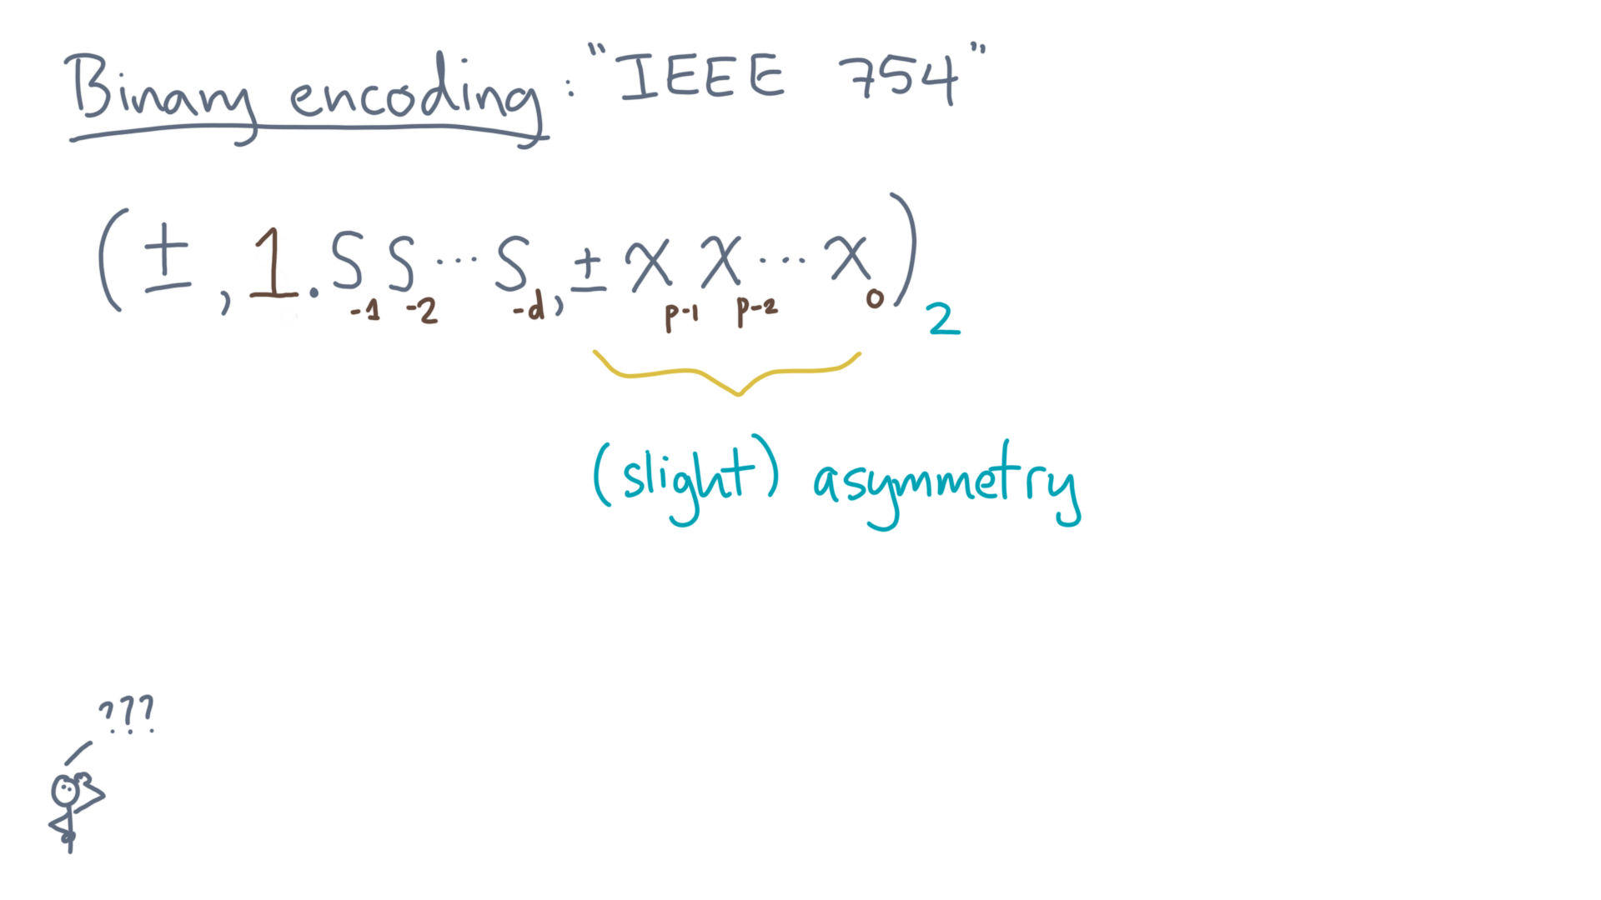
Notes:
So what does that mean and why?
Let’s take an example.

Slide 19
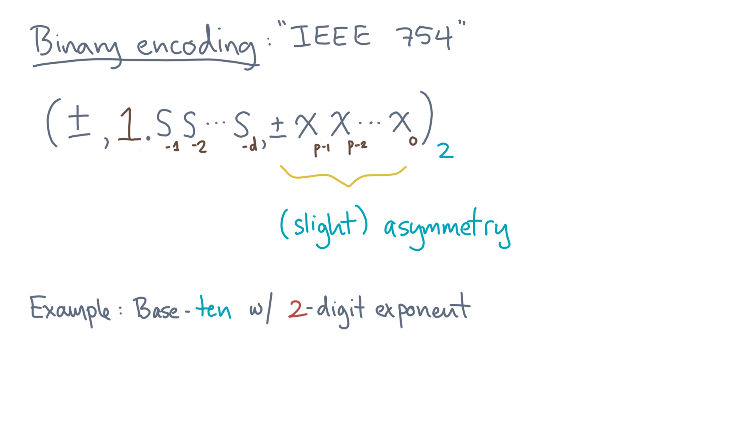
Notes:
Suppose we are back in base ten with a two-digit exponent.
What’s the exponent range?

Slide 20
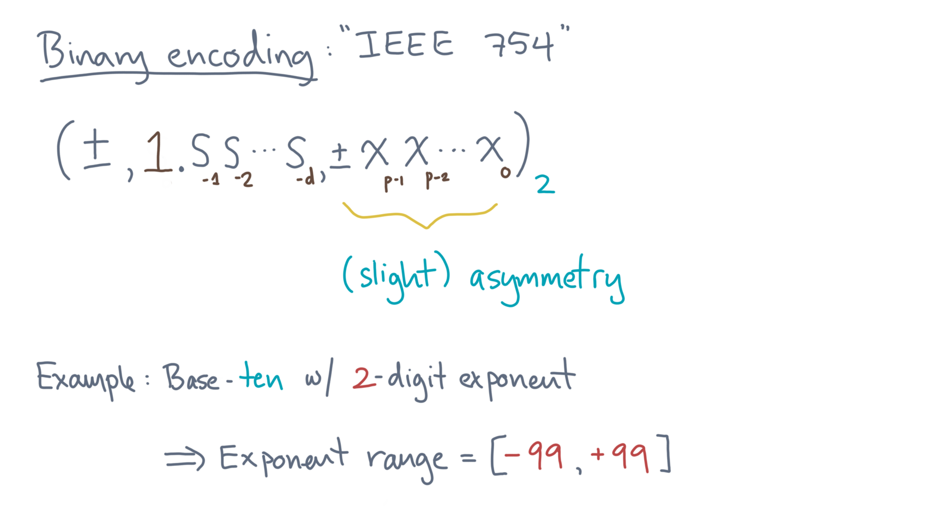
Notes:
If you get two digits, then it’s the interval from minus 99 to plus 99.
That’s symmetric about zero.

Slide 21
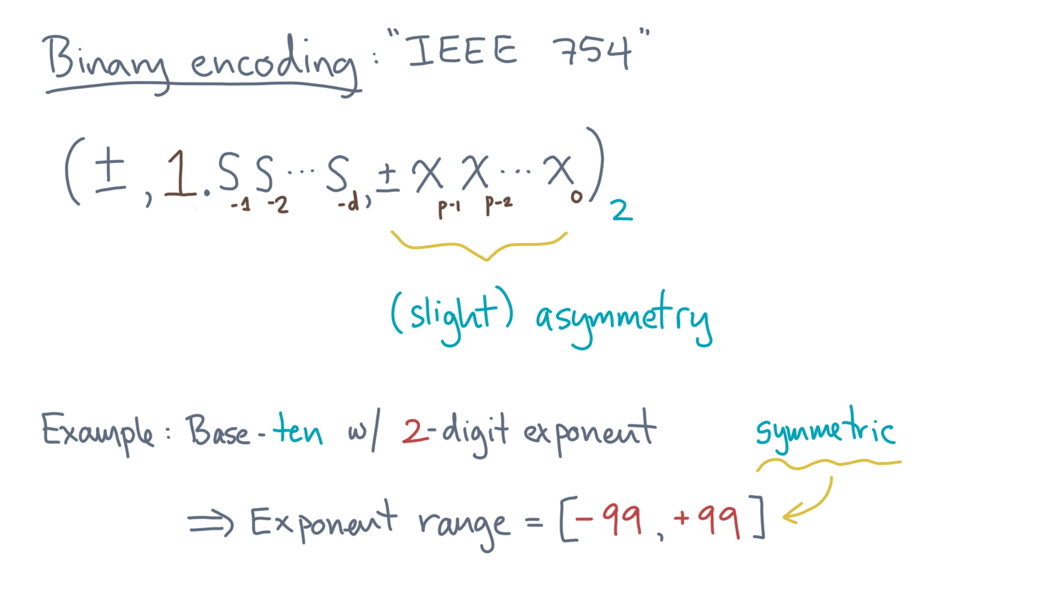
Notes:
The standard will specify a non-symmetric interval.
The main reason is so the format can encode special values, like a symbolic Infinity.

Slide 22
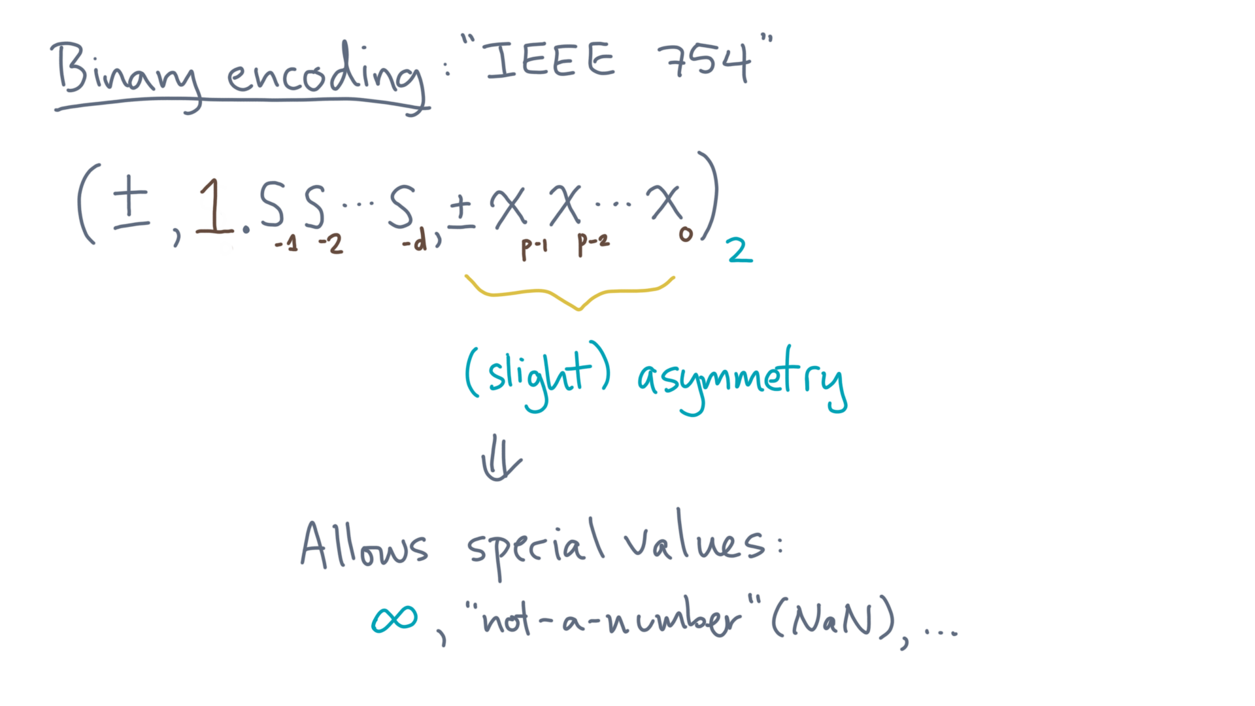
Notes:
There’s even a special “not-a-number” value, or “NaNs.”

Slide 23

Notes:
You can generate NaNs when you do things like zero-divided-by-zero.
[image credit from “The Prisoner”: https://ih1.redbubble.net/image.119421570.0739/flat,1000x1000,075,f.jpg]

Slide 24
Notes:
In fact, you’ve probably encountered NaNs in your favorite statistics package, as it’s sometimes used to represent missing values.

Slide 25

Notes:
IEEE-754 says some other important things.
One is to define some standard sizes, which we can then rely on being available on any compliant hardware.
The first most important one is known as “single-precision.”

Slide 26
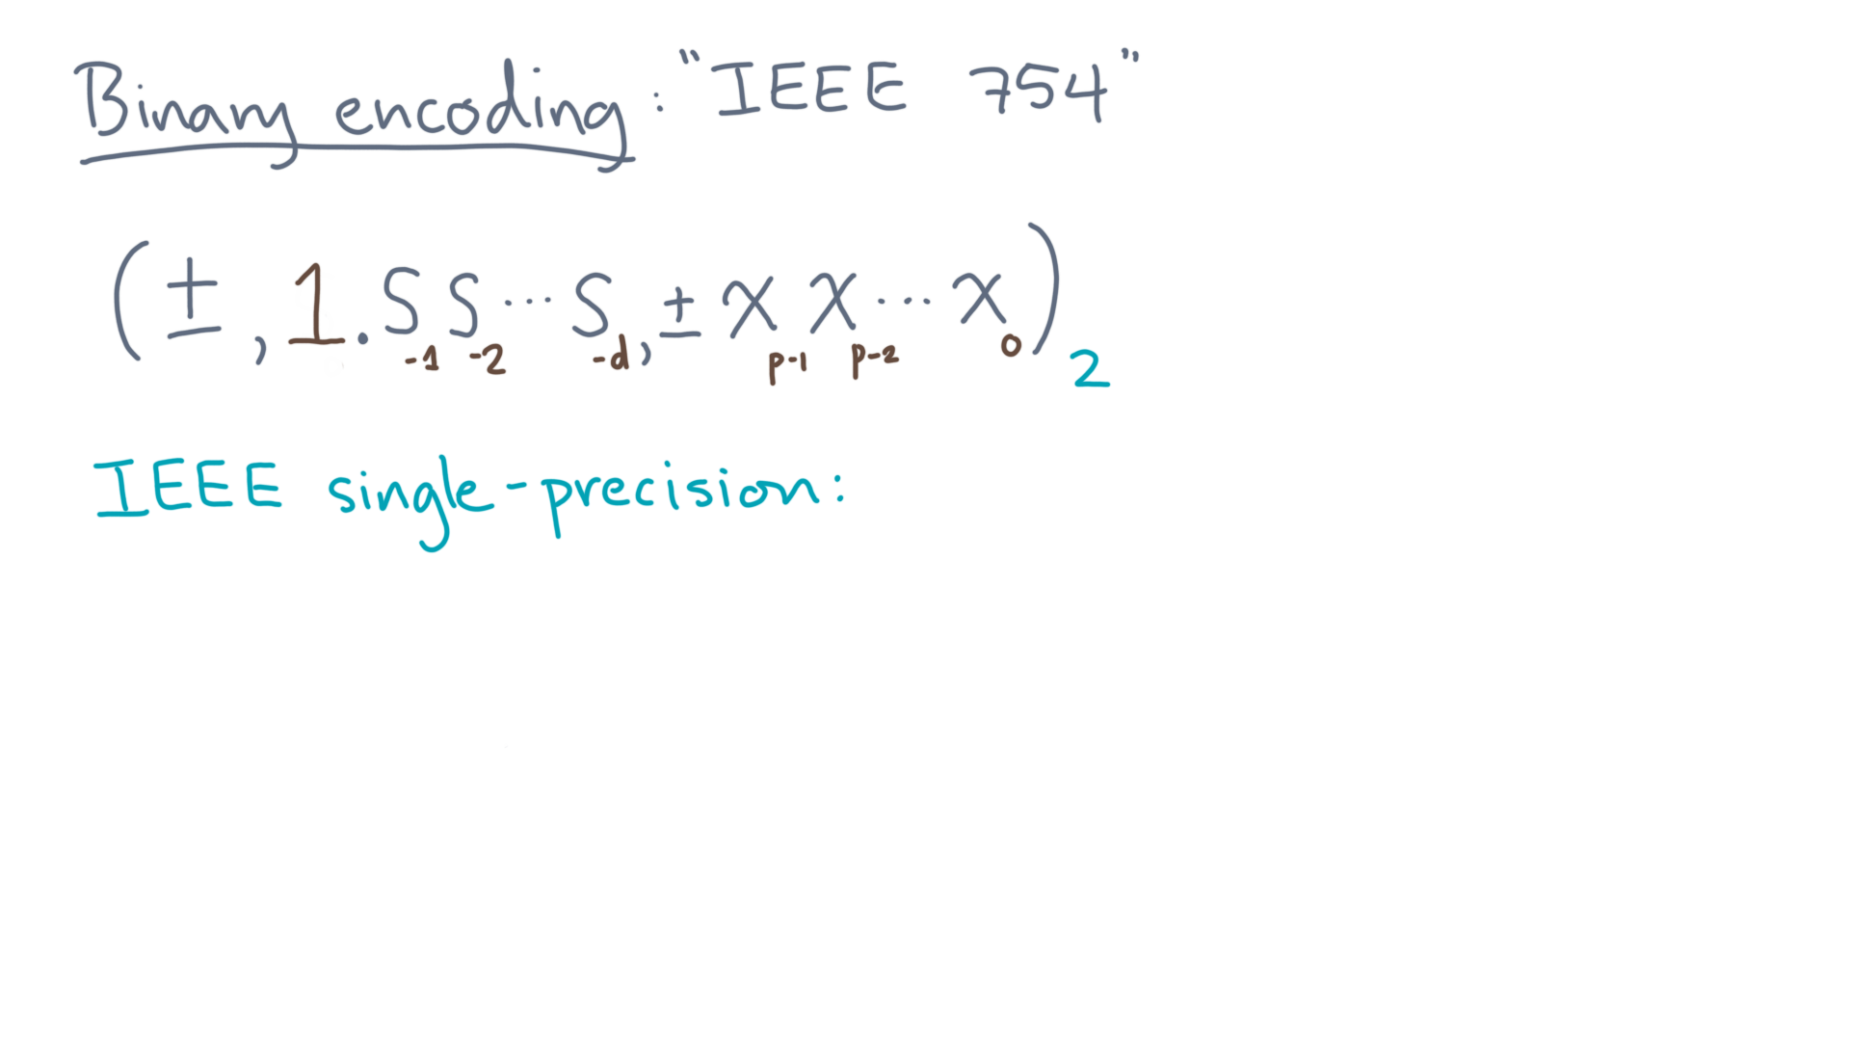
Notes:
If you’ve used C, C++, or Java, it’s available to you via the “float” primitive type.

Slide 27
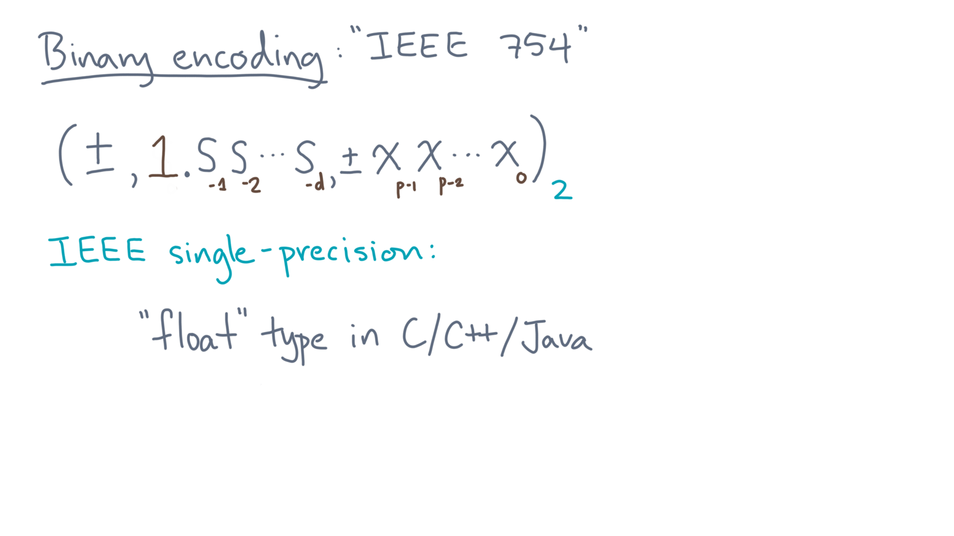
Notes:
With it, you get a total of 32 bits to store your number.

Slide 28
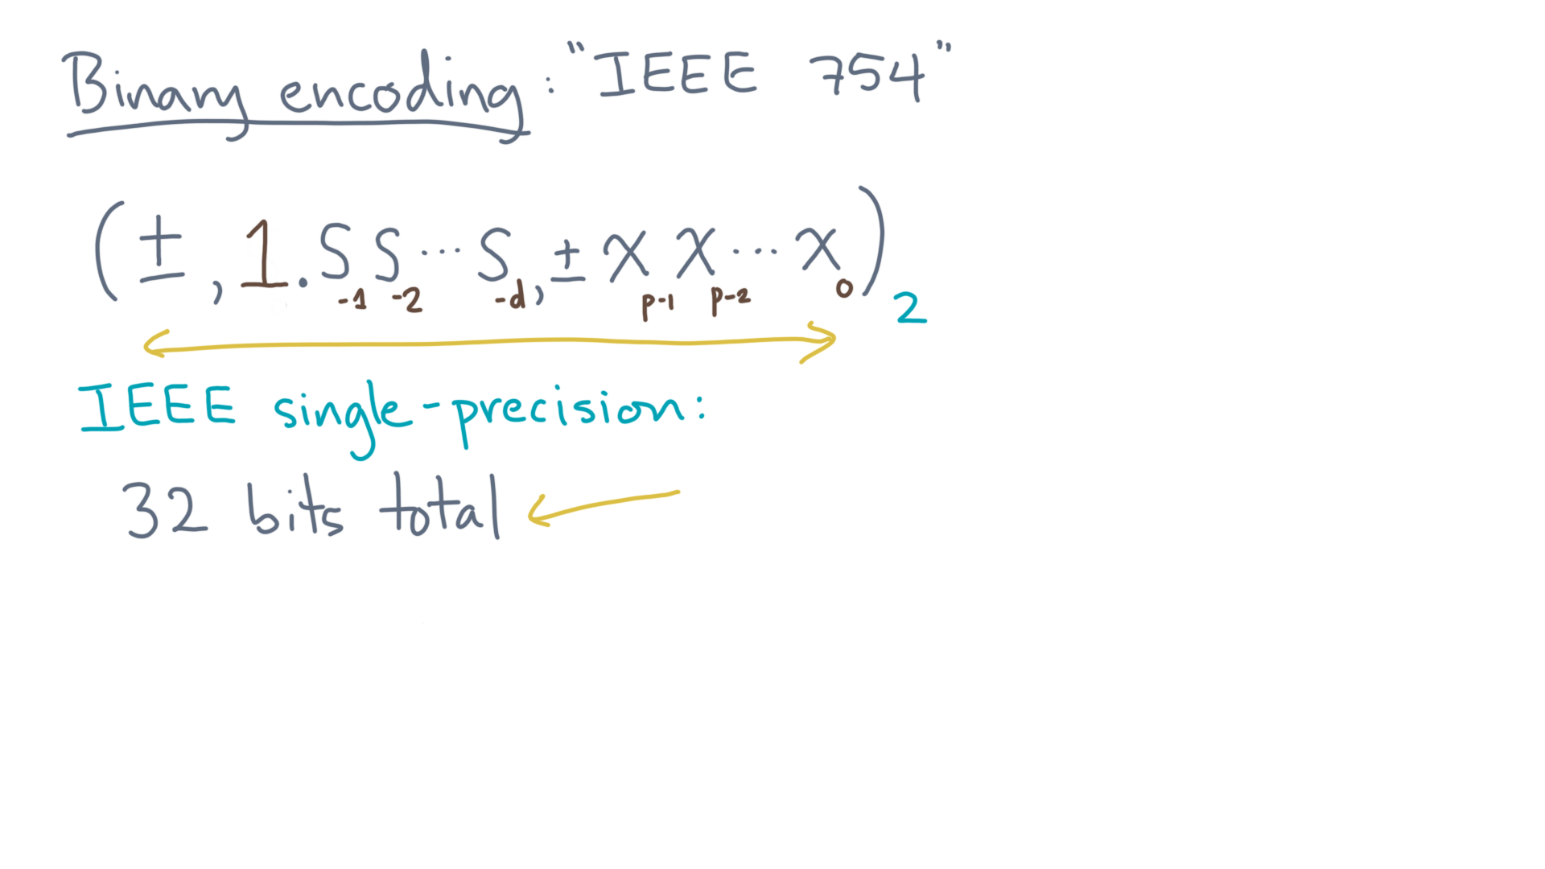
Notes:
There is one bit for the sign, of course.

Slide 29
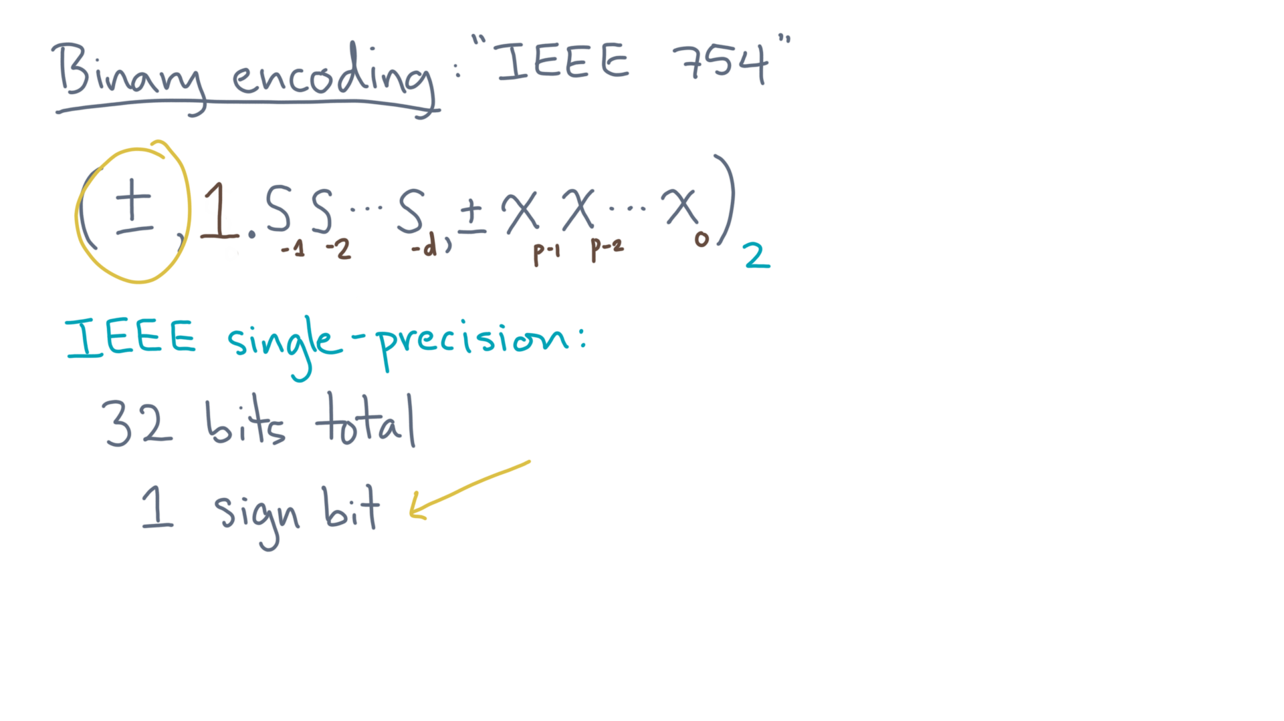
Notes:
What about the significand?

Slide 30
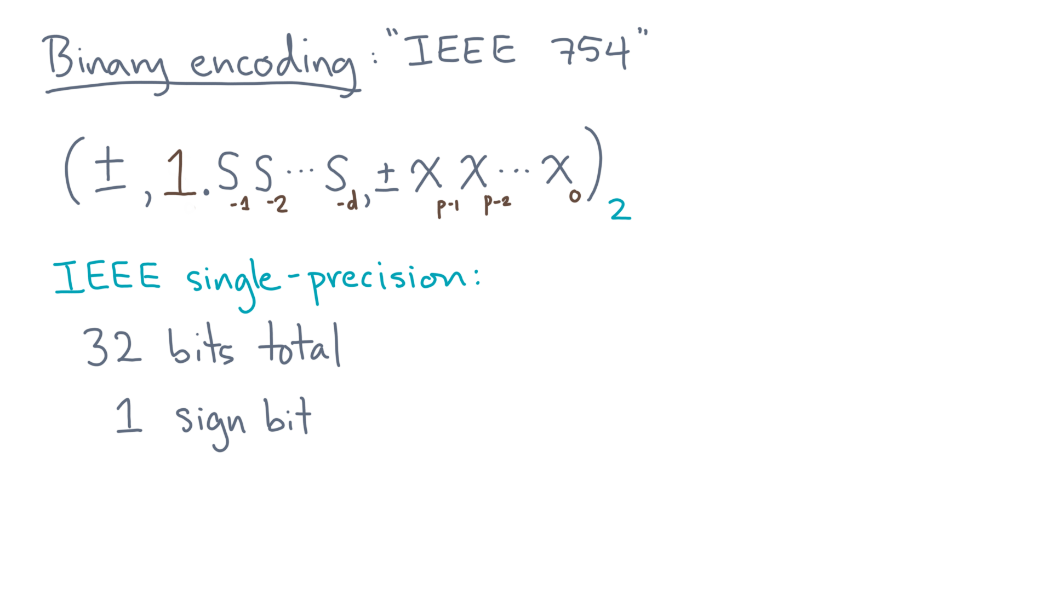
Notes:
For that, you get 24 bits.

Slide 31
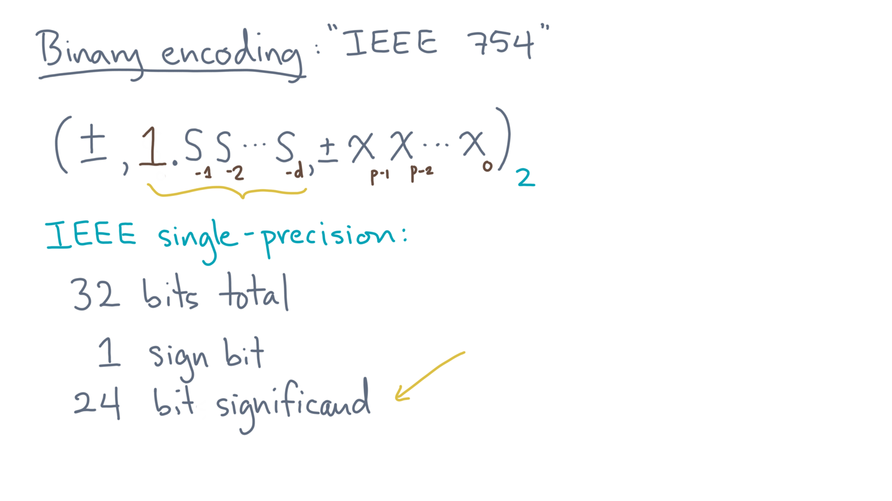
Notes:
Lastly, there is the exponent.

Slide 32
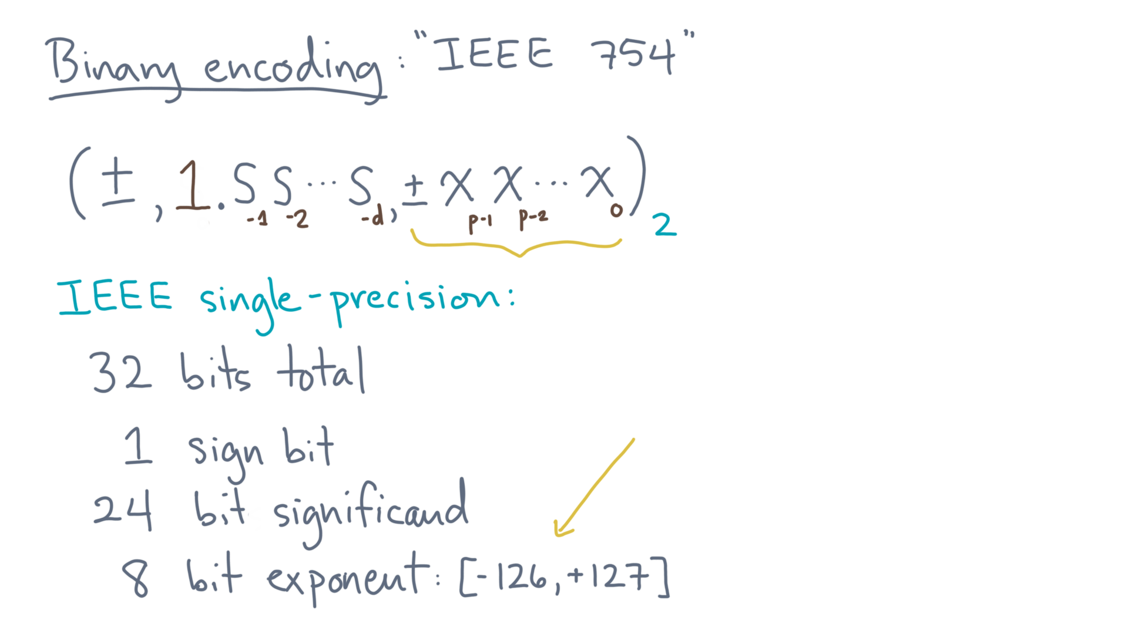
Notes:
For that, you get 8 bits.

Slide 33
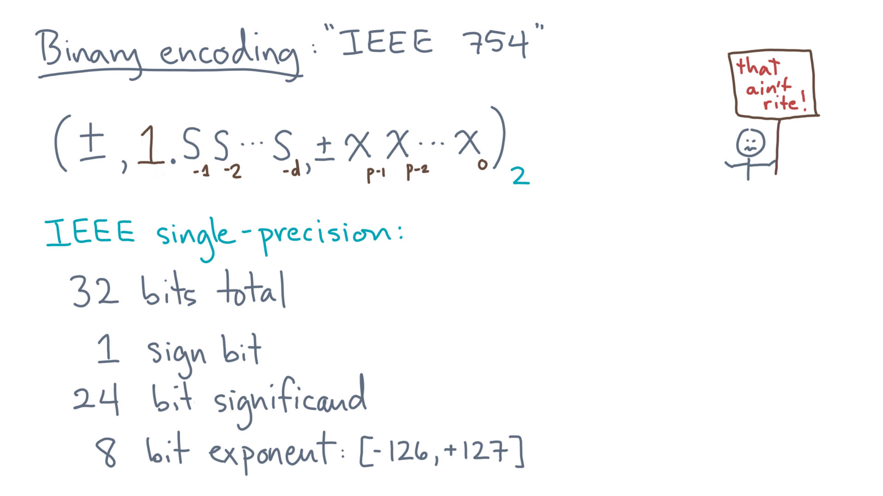
Notes:
Now seeing these values, you might protest!

Slide 34
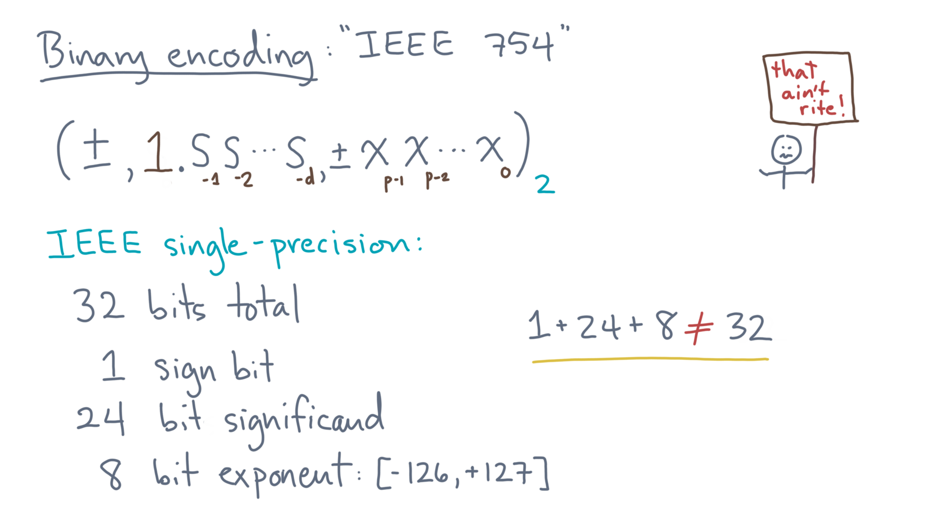
Notes:
After all, 1 plus 24 plus 8 is 33, not 32!
So what’s going on?

Slide 35
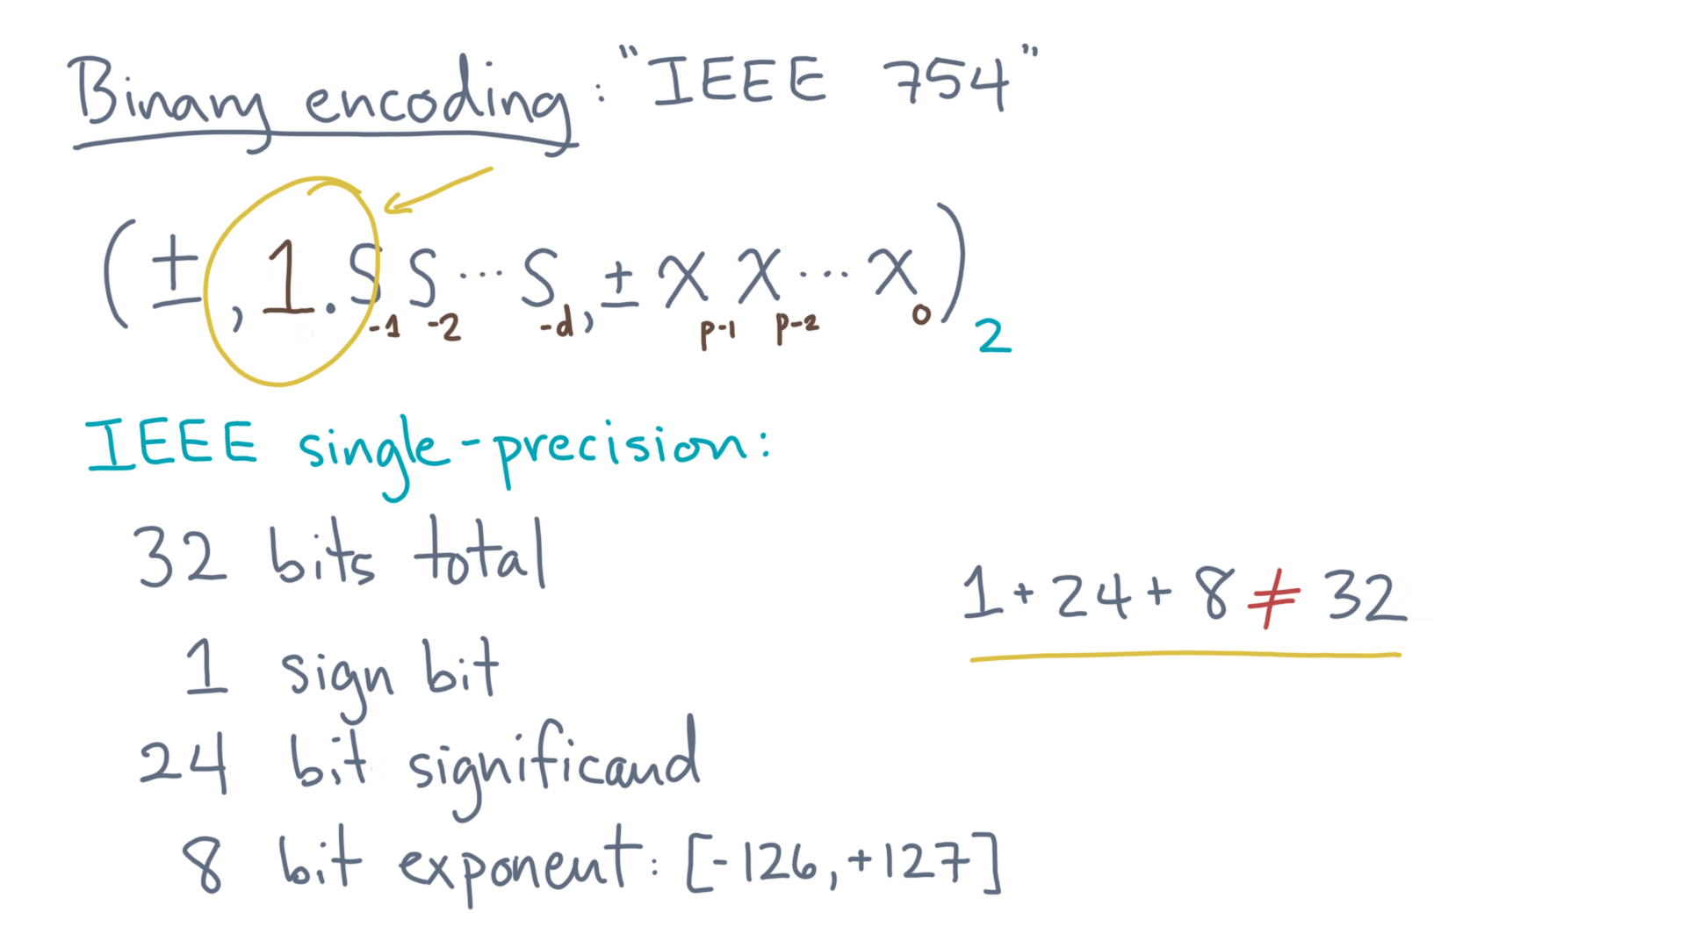
Notes:
Remember that the leading 1 is always there for any non-zero, so you don’t need to store it!
So although we represent the significand using 24 bits, you only need to store the 23 bits that comprise the fraction.

Slide 36
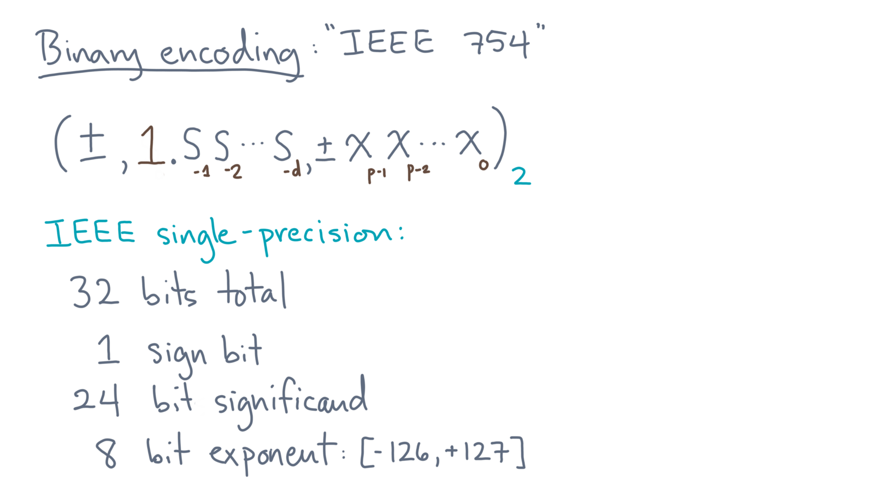
Notes:
So let’s see what this configuration of bits implies.
First question.

Slide 37
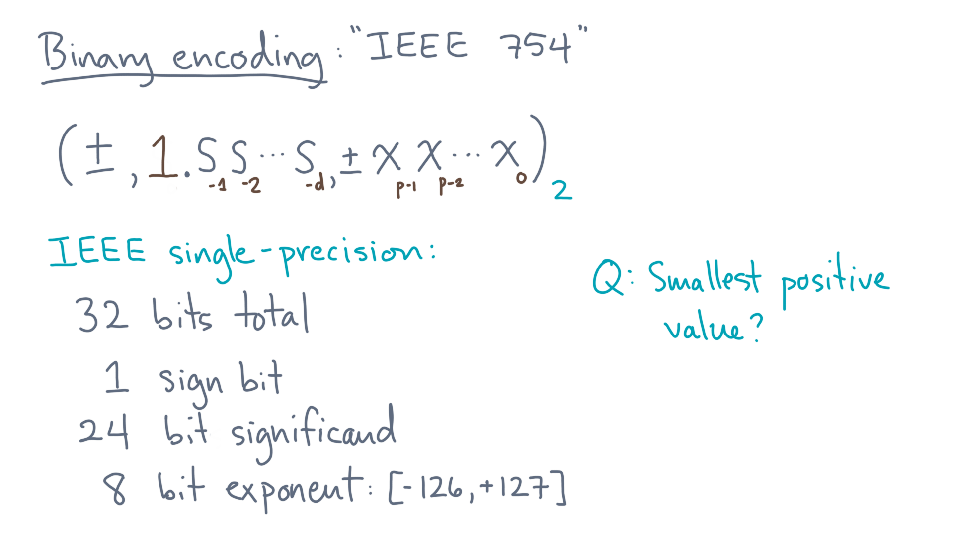
Notes:
What is the smallest possible positive value?
You might pause now for a moment to think about it first.
Since its positive, let’s start with the significand.

Slide 38
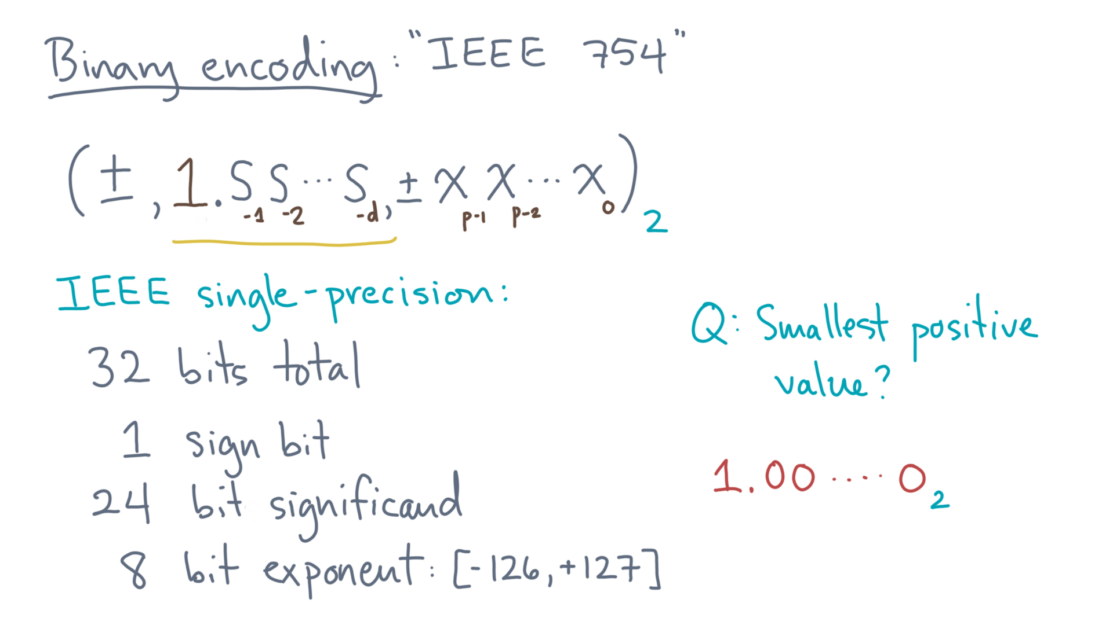
Notes:
The smallest value has the implicit 1 followed by all zeroes.

Slide 39
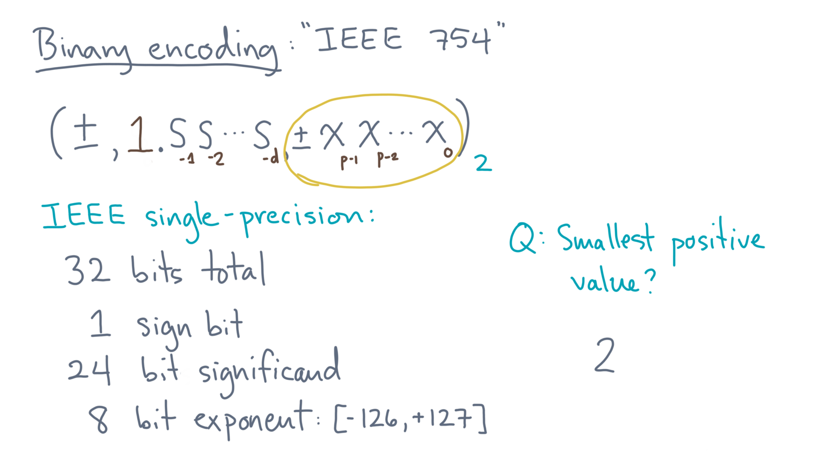
Notes:
So that’s two, raised to some exponent.
What’s the smallest exponent?

Slide 40
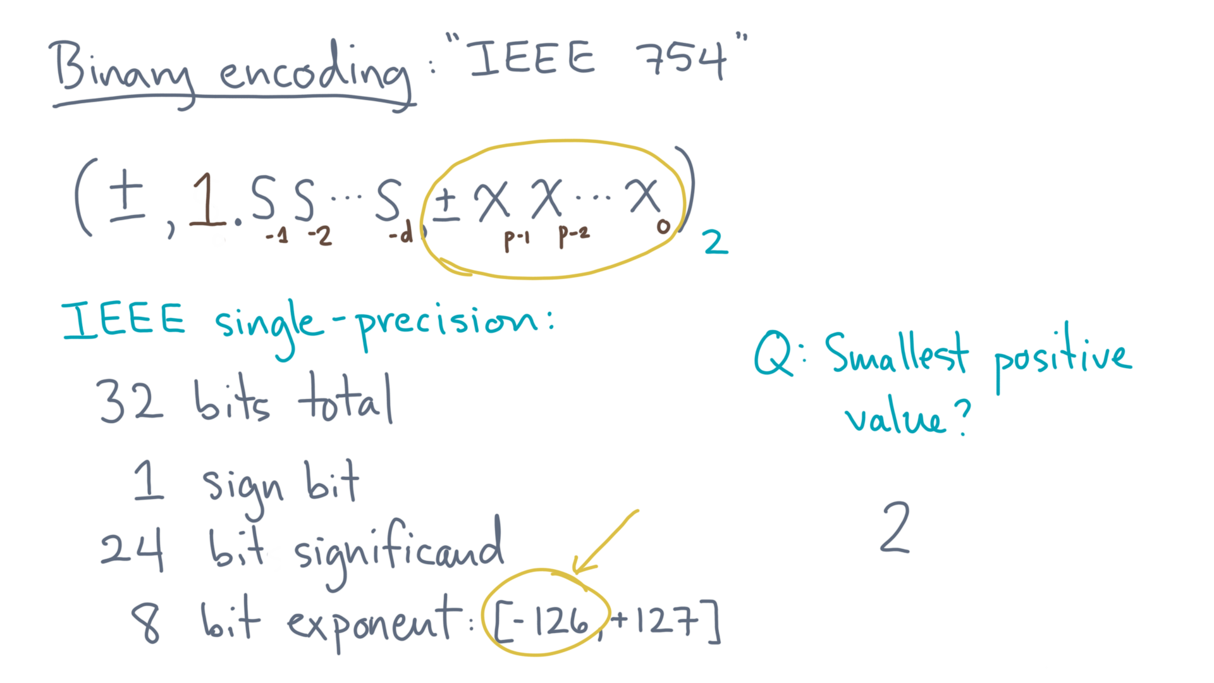
Notes:
According to the standard, it’s negative 126.

Slide 41
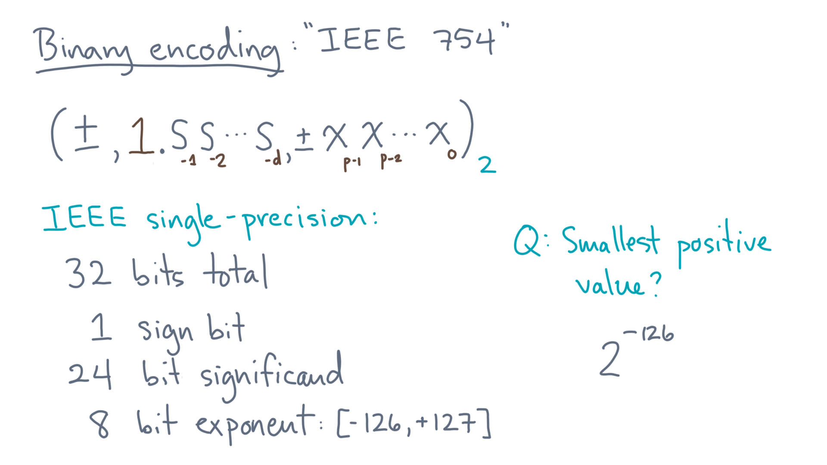
Notes:
So that’s the answer: 2 raised to the power minus 126.

Slide 42
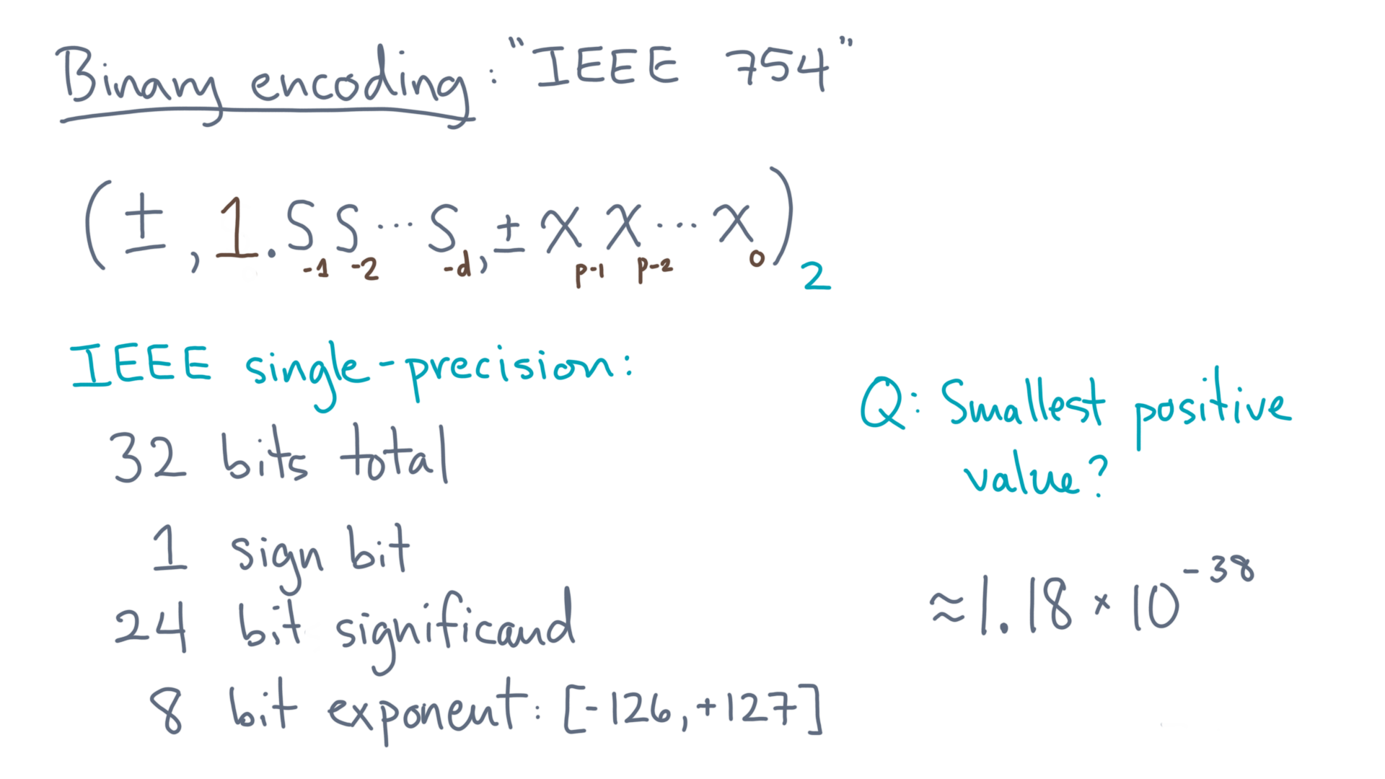
Notes:
The base 10 equivalent is about 1.18 times ten to the minus 38, which is a pretty small number.
Just for reference, the smallest known particle is a quark, which is about 10 to the power minus 18 meters.
So this smallest single-precision value is tiny!

Slide 43
Notes:
Now let’s ask another question.

Slide 44
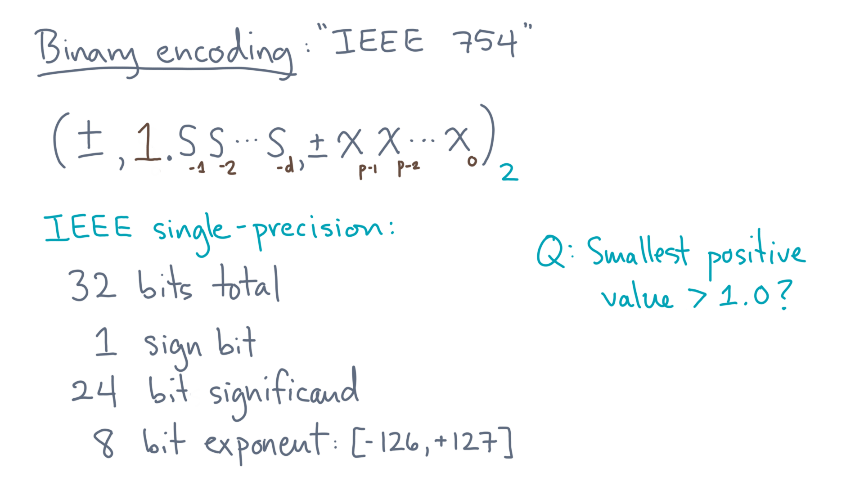
Notes:
What’s the smallest positive value *greater than* 1?
Again, pause for a moment to see if you can figure it out first.
I suggest starting with the exponent.

Slide 45
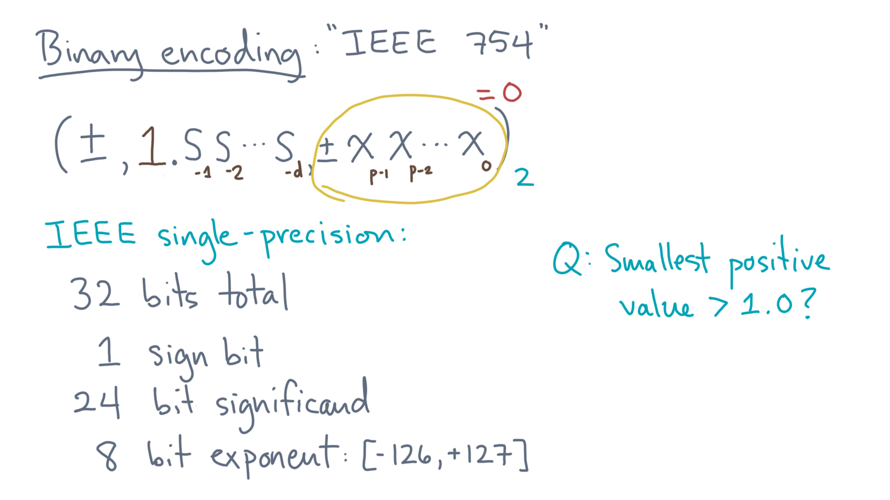
Notes:
We want a value that is more than 1, so the smallest possible exponent is 0.

Slide 46
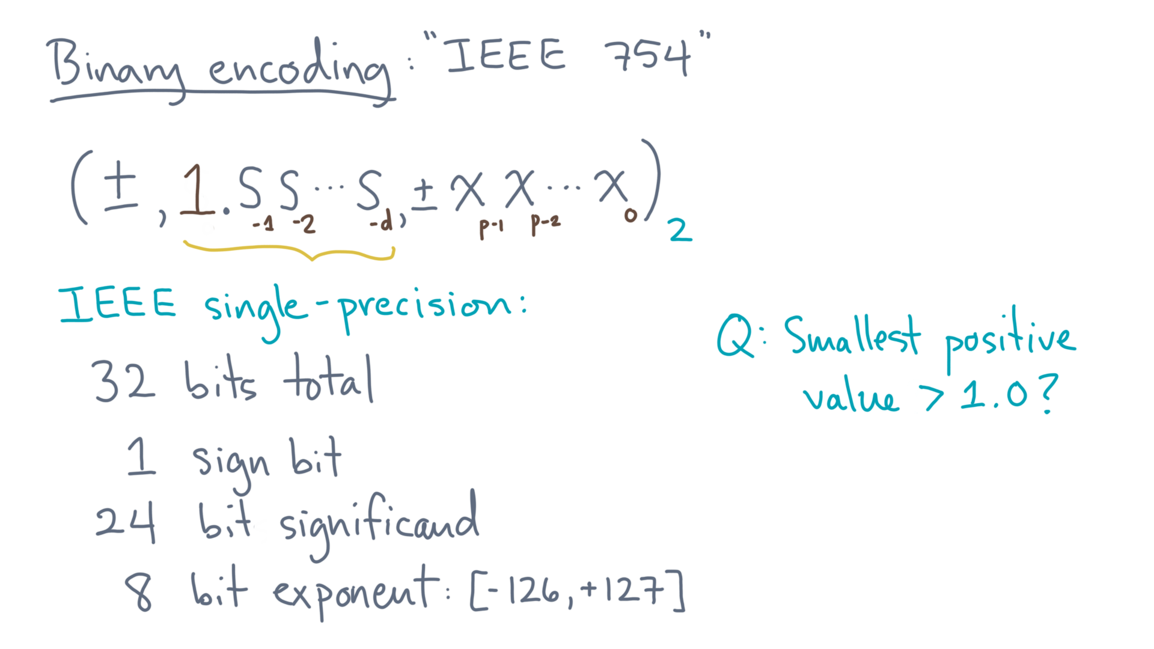
Notes:
That leaves us with the significand.
What value do we want?

Slide 47
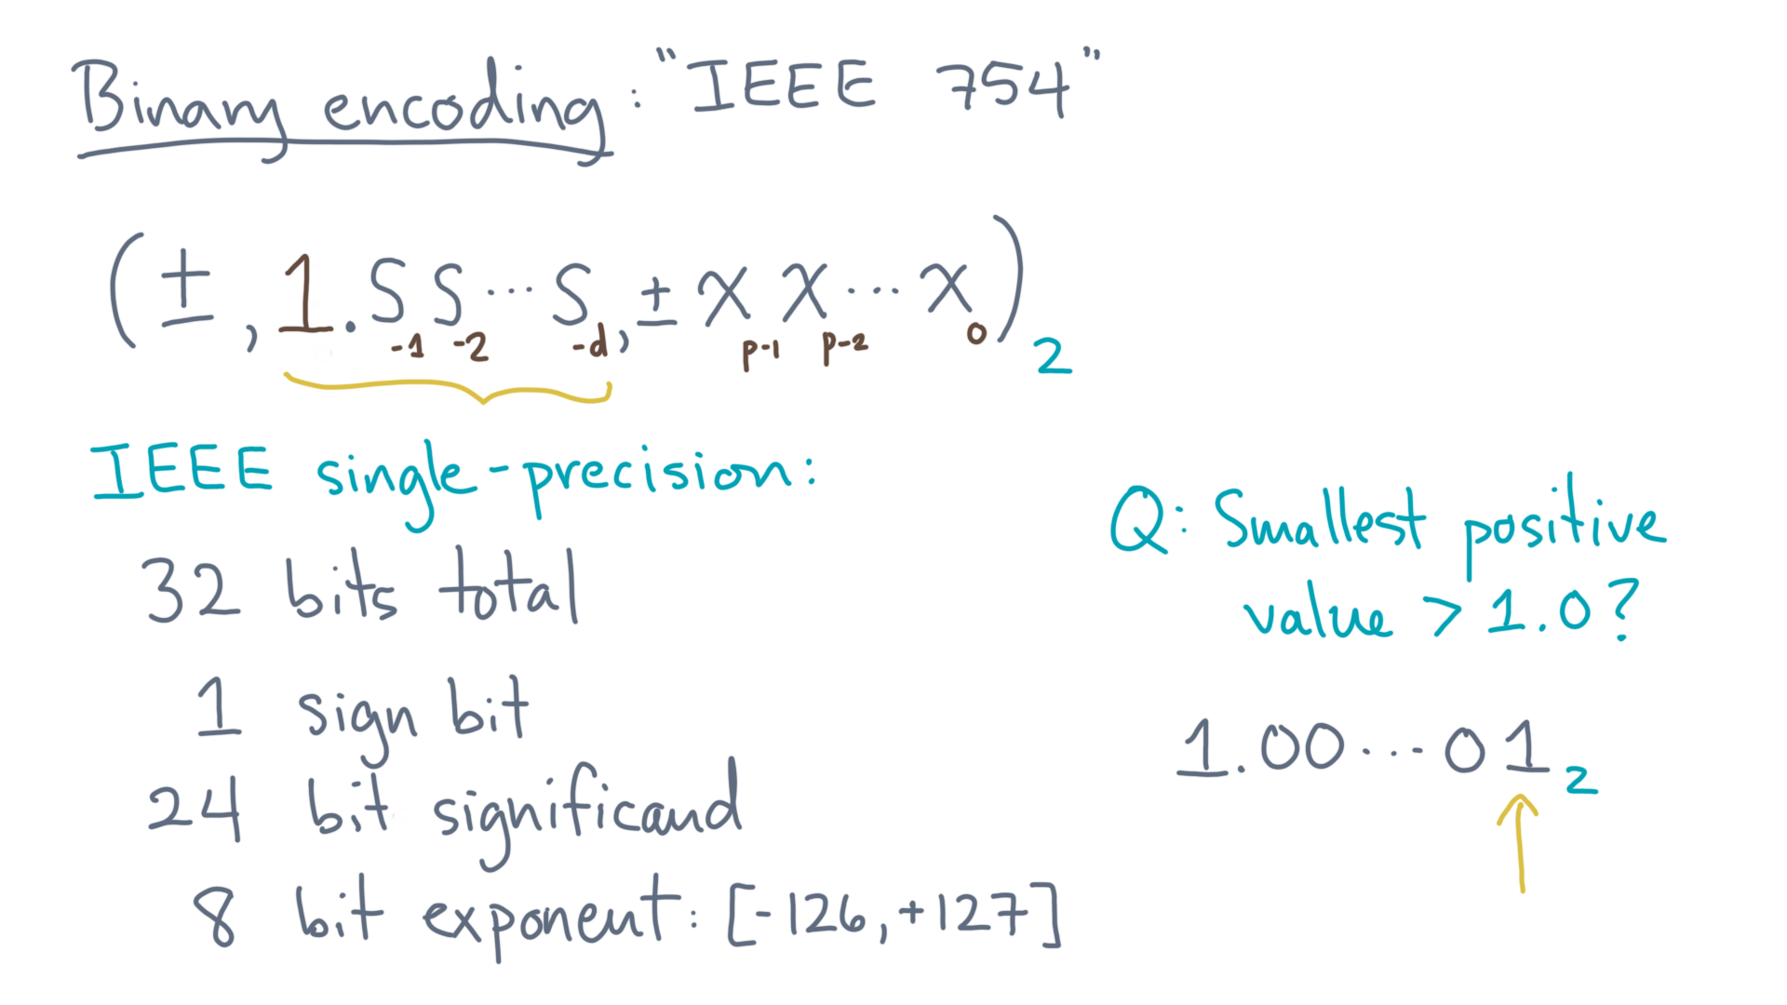
Notes:
The smallest value has a 1 in the rightmost, or “least significant”, bit.

Slide 48
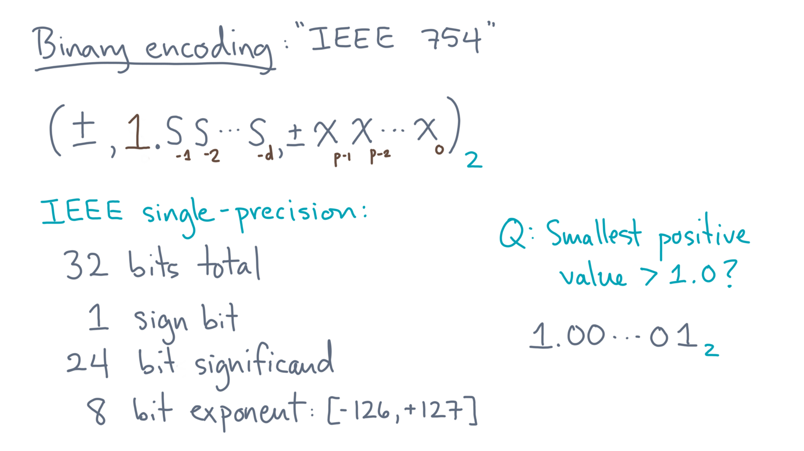
Notes:
Now this particular value has a special significance.
In particular, think of it in the form, “1 plus epsilon.”

Slide 49
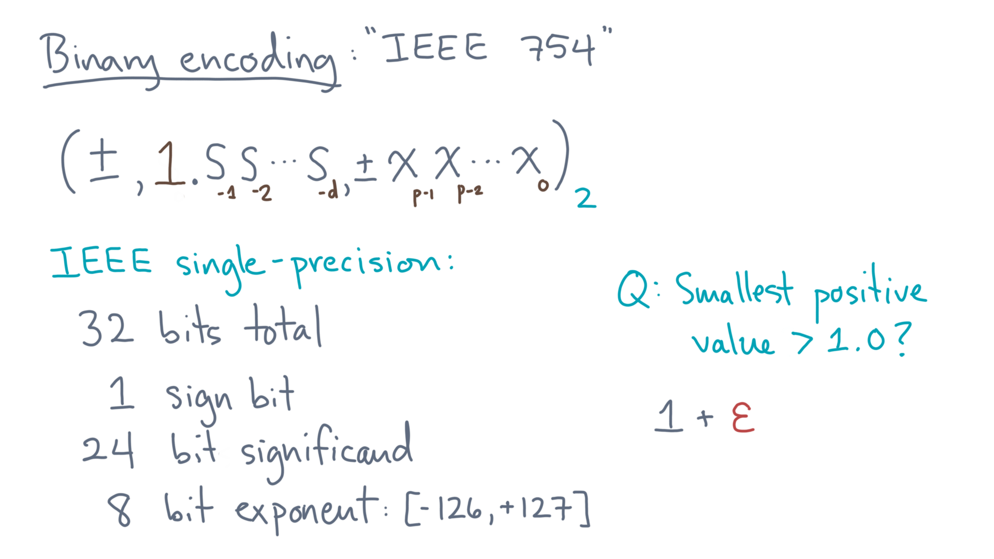
Notes:
What does “epsilon” tell you?
Well, any time you make a rounding error, any bits corresponding to values smaller than epsilon might be lost.
So I would claim that it represents the largest relative error after rounding.

Slide 50
Notes:
Take a moment to see why.

Slide 51
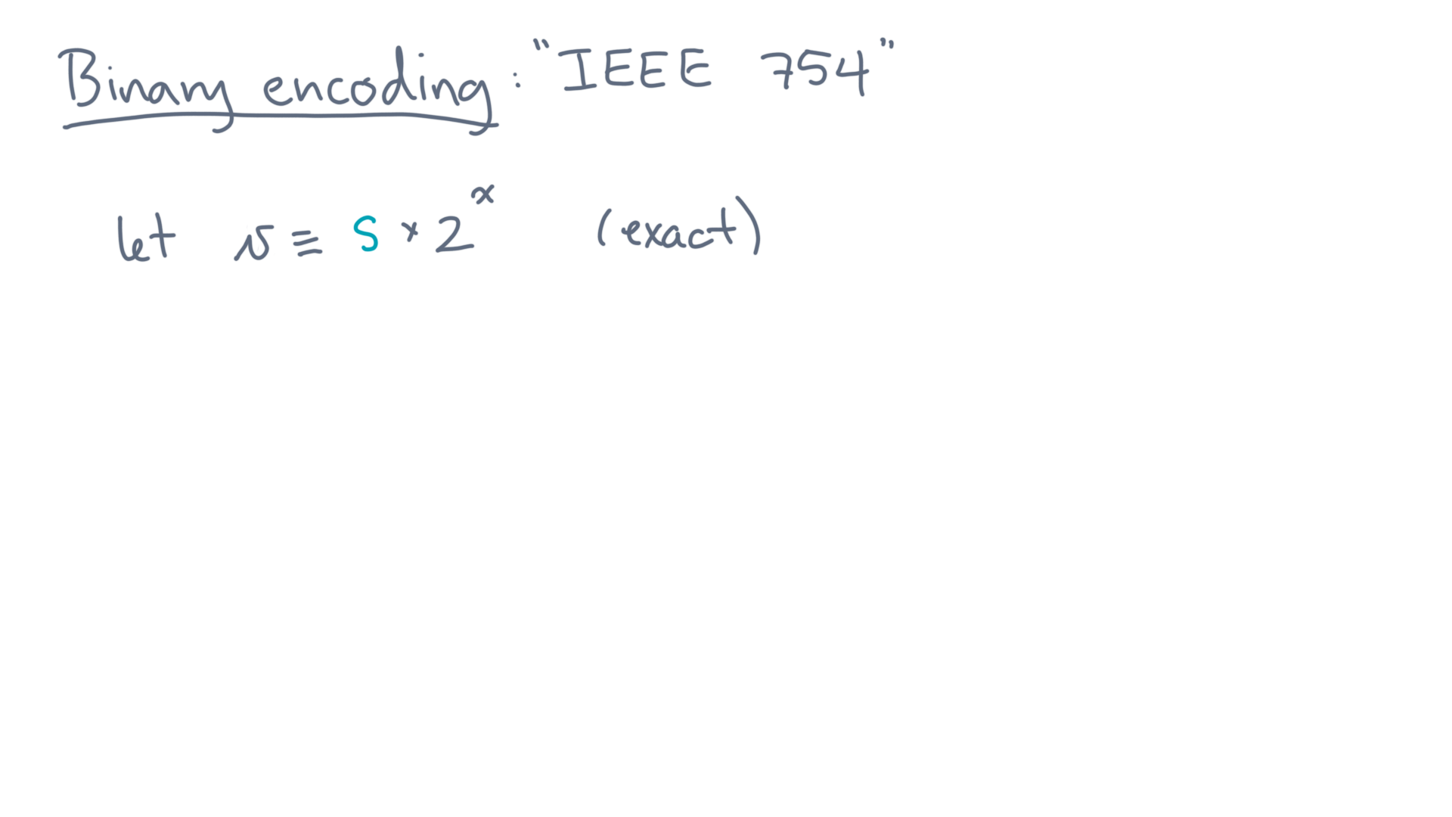
Notes:
Let “vee” be the *exact* mathematical value of some number, written as a significand “s” times two to some integer exponent, “x”.

Slide 52
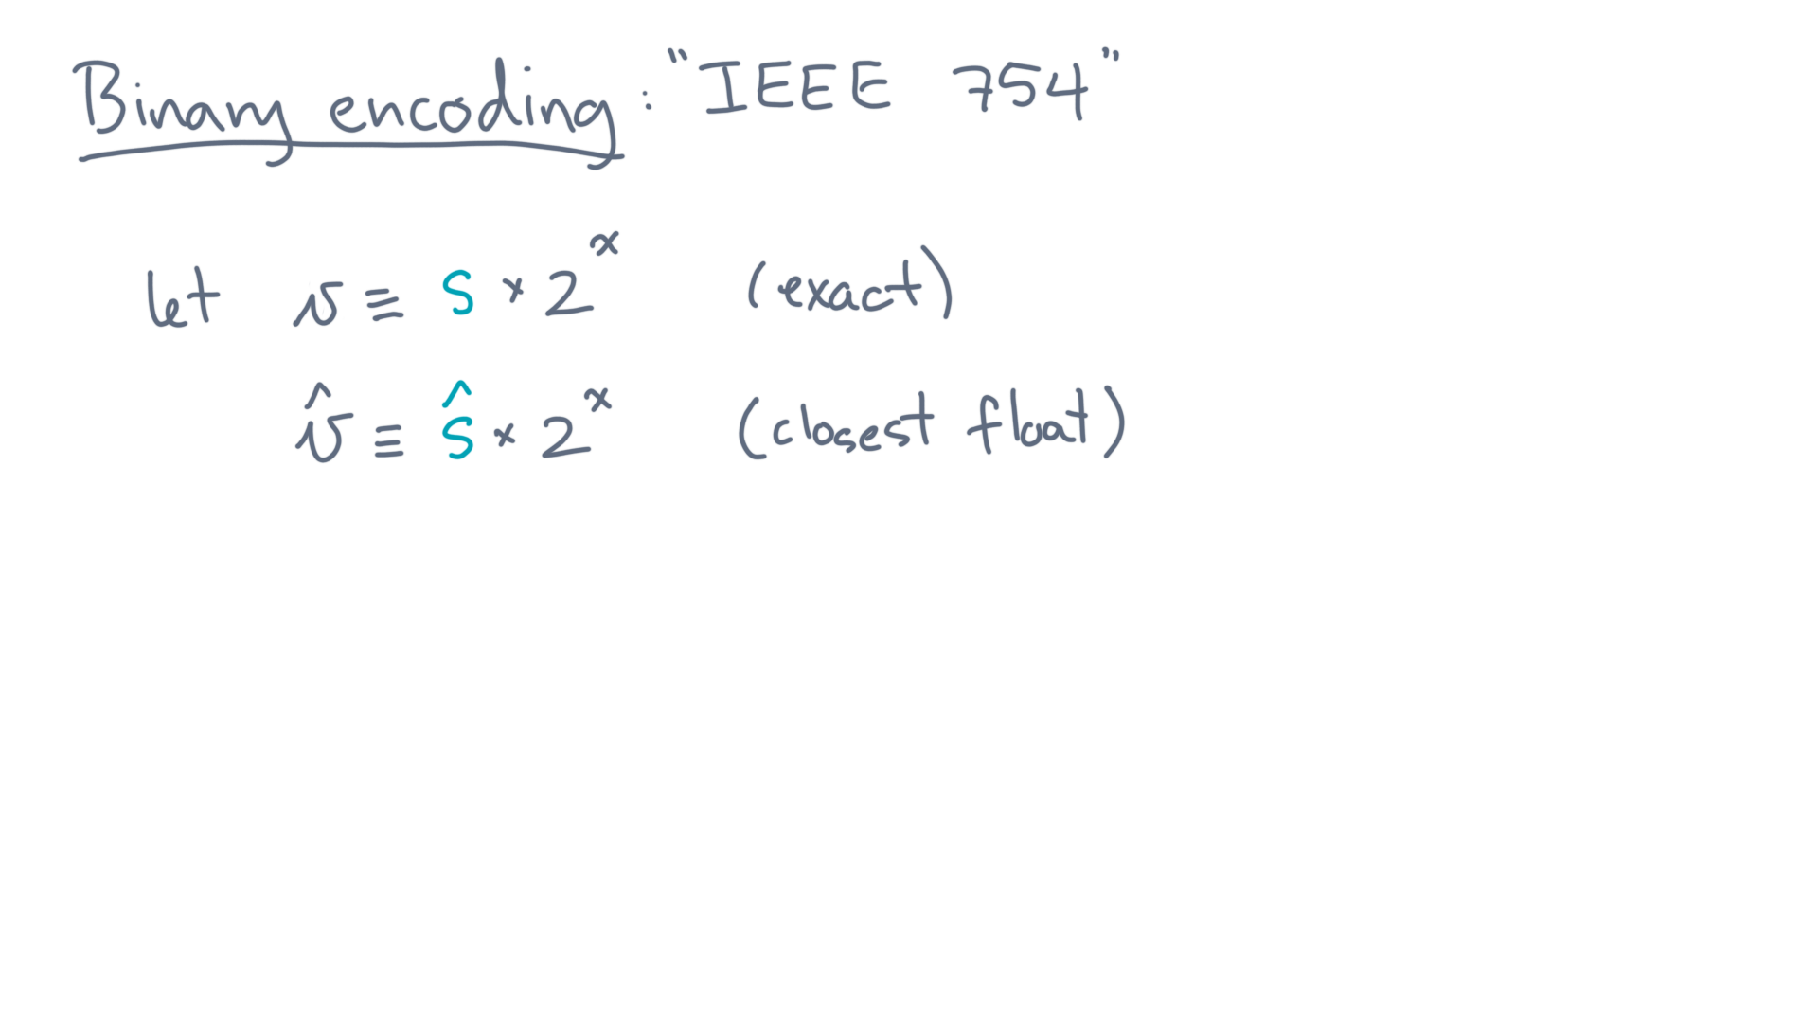
Notes:
Let “v-hat” denote the floating-point value that is closest to “v”.
Assume the exponent range is large enough to contain “v”, so that the 2 to the “x” part is the same for both values.

Slide 53
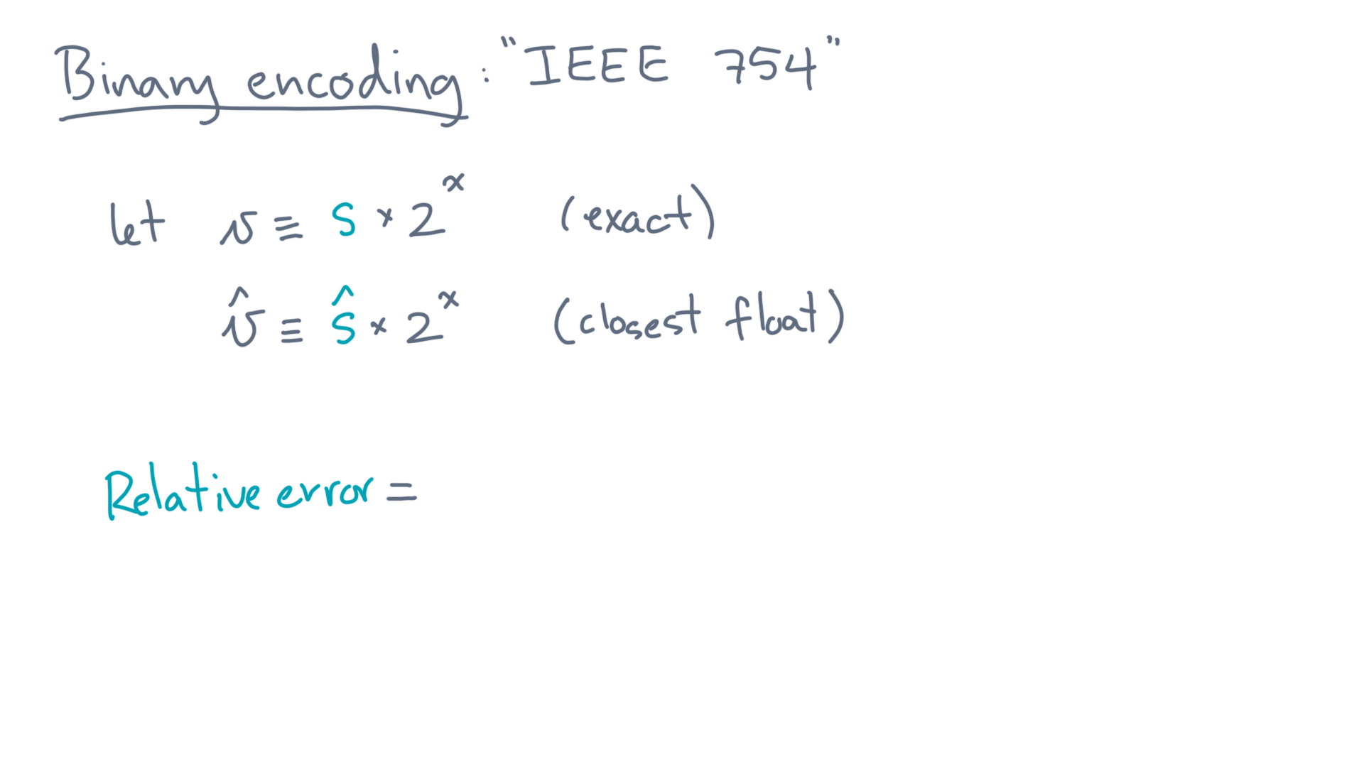
Notes:
So what is the relative error?

Slide 54
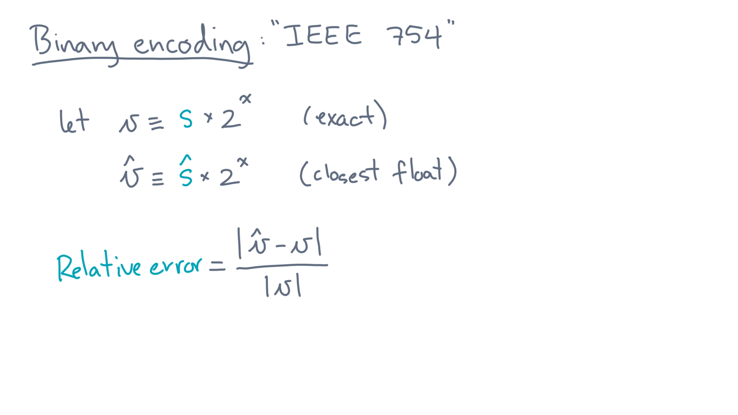
Notes:
It’s just the absolute difference between “v-hat” and “v” normalized by the magnitude of “v”.
That can be rewritten in terms of the significands.

Slide 55
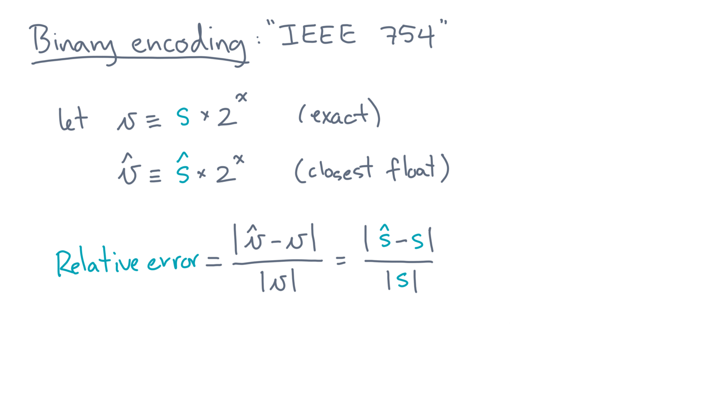
Notes:
It’s basically just their relative difference, since the exponent factors cancel.
So how large is this? Consider the numerator, “s-hat” minus “s”.

Slide 56
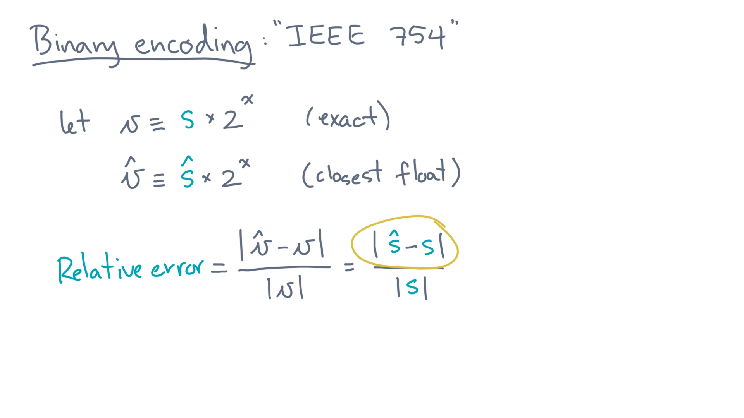
Notes:
The true significand might look like this.

Slide 57
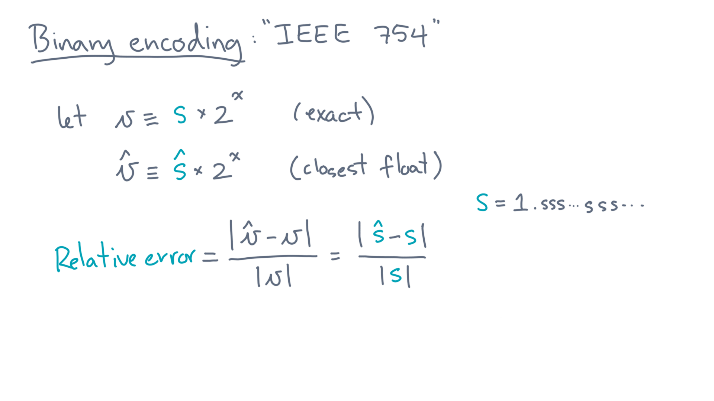
Notes:
One plus a possibly long string of digits.
What about the floating-point significand, “s-hat”?

Slide 58

Notes:
Since it’s floating-point, it has to stop at some point.

Slide 59

Notes:
In other words, it will be a truncated---and possibly rounded---value near the true significand.
And how large could the difference be?

Slide 60

Notes:
That’s right, epsilon.
So that bounds the relative error.

Slide 61

Notes:
It can’t be larger than epsilon divided by the true significand.

Slide 62

Notes:
As for the true significand, it must be at least one for any non-zero “v”.

Slide 63

Notes:
Thus, the relative error is at most epsilon.
Ok, so let’s pick up where we left off, which was the analysis of single-precision.

Slide 64
Notes:
Because this epsilon has a special significance, let’s give it a name.

Slide 65

Notes:
We’ll refer to it as “machine epsilon.”
Its value will, of course, depend on the number of bits of the significand.

Slide 66

Notes:
In this case, its value is 2 to the power minus 23.

Slide 67

Notes:
In base 10, that’s about 1.19 times ten to the power minus 7.

Slide 68
Notes:
Now the standard defines at least one more canonical format.
It’s called double-precision.

Slide 69

Notes:
In languages like C, C++, and Java, it goes by the primitive type name “double.”

Slide 70

Notes:
More importantly for this class, in languages like Python and R, it is the *default* type.
Here is how it is configured.

Slide 71

Notes:
It’s a 64-bit type, rather than 32 in single.
And the significand and exponent are 53 bits and 11 bits.
Based on our analysis of single-precision, you might ask yourself, for instance, what’s the smallest positive value? Or what’s machine epsilon for double-precision?

Slide 72
Notes:
I realize that was a lot of detail, so let me remind you of what I think is the most important takeaway.
It’s the concept of “machine epsilon.”
It’s a value that depends on the floating-point format, and it bounds the largest relative error due to roundoff.
In the next lesson, we’ll see how to use that fact.

